Slide 1
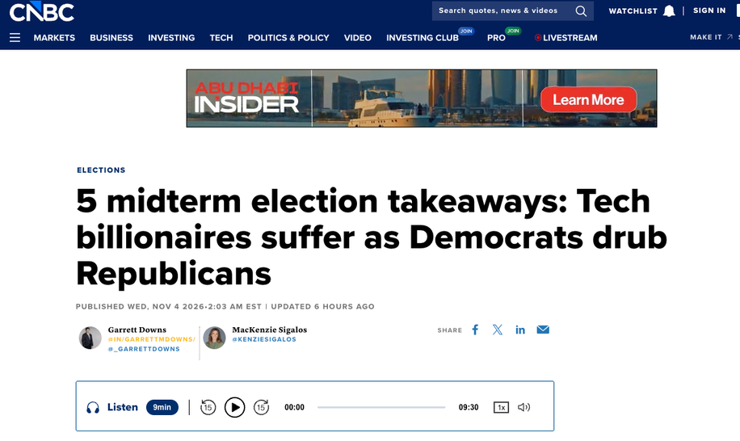
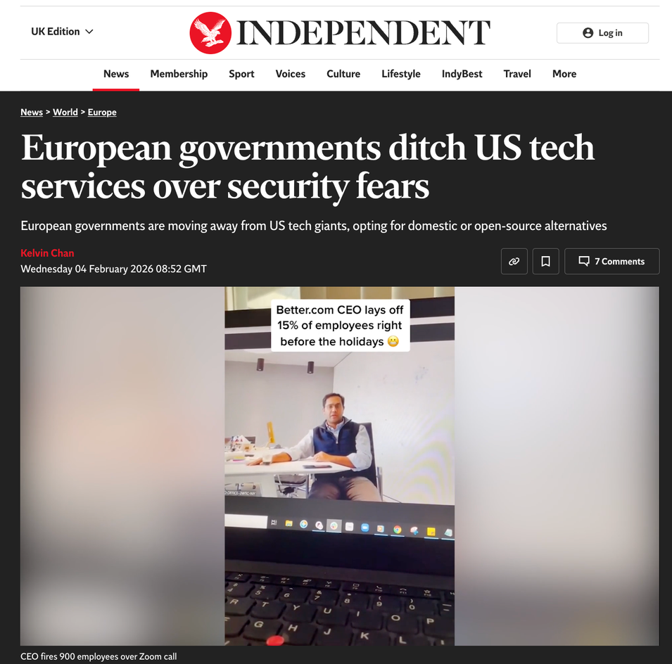
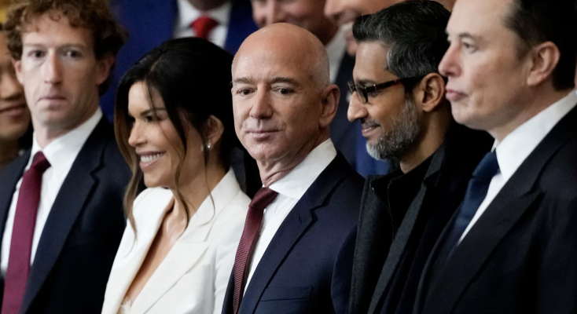
Notes:
Today’s lecture is built as five short acts. Each starts with a puzzle you answer before I tell you what happened. Keep a note of which error you think matters most for your project country: that is your exit ticket.
2

Slide 2
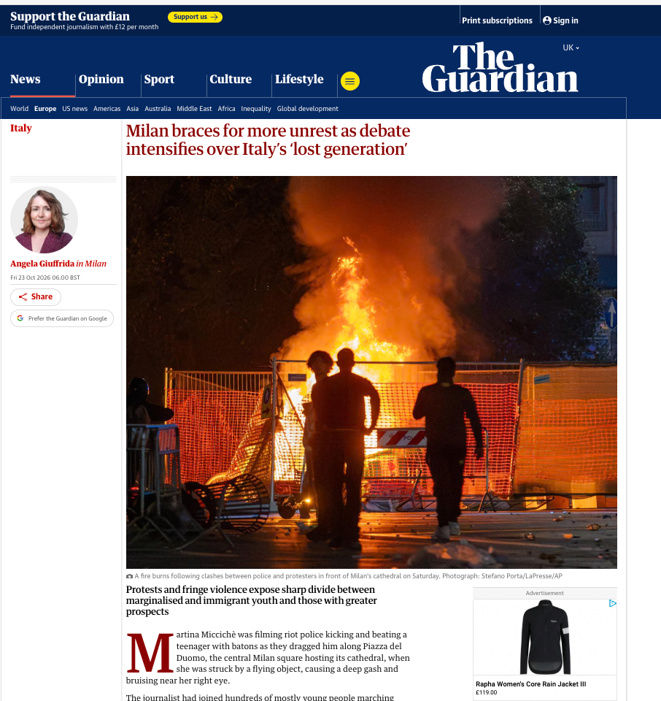
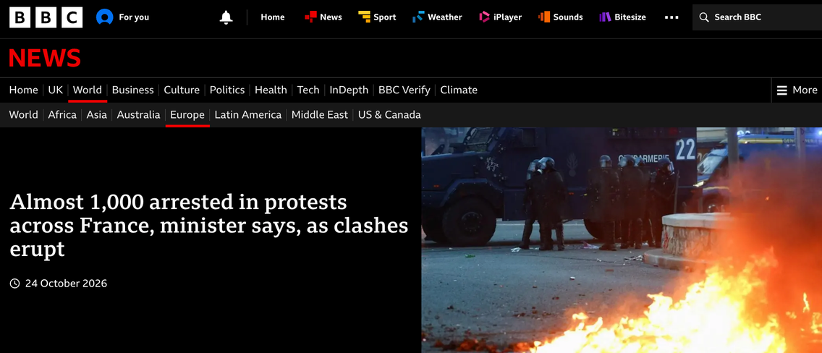
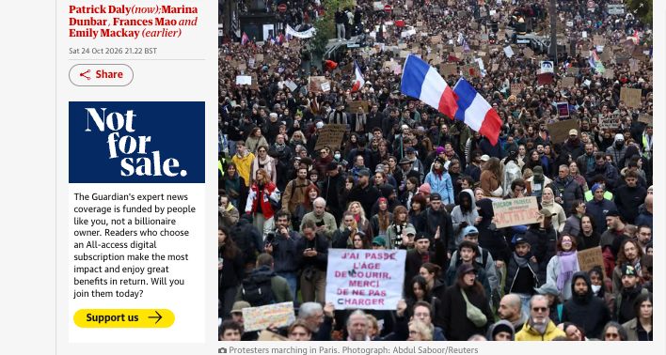
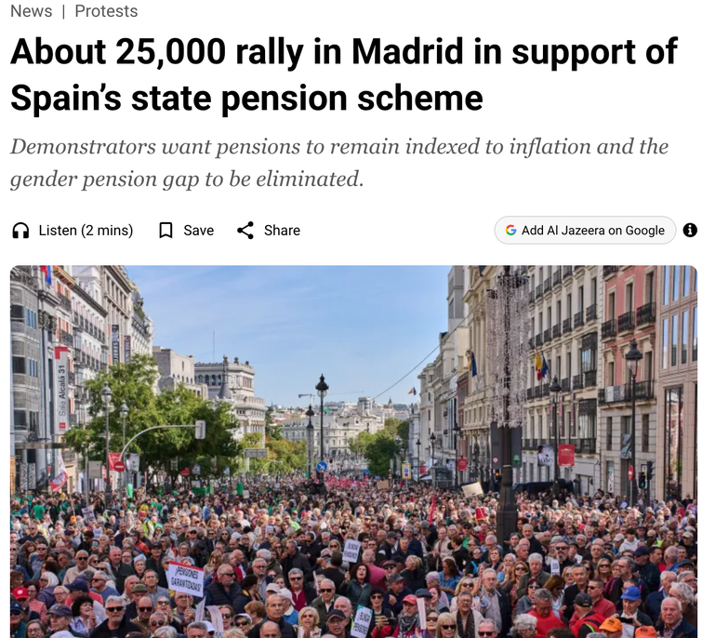
Notes:
Today’s lecture is built as five short acts. Each starts with a puzzle you answer before I tell you what happened. Keep a note of which error you think matters most for your project country: that is your exit ticket.
2

Slide 3
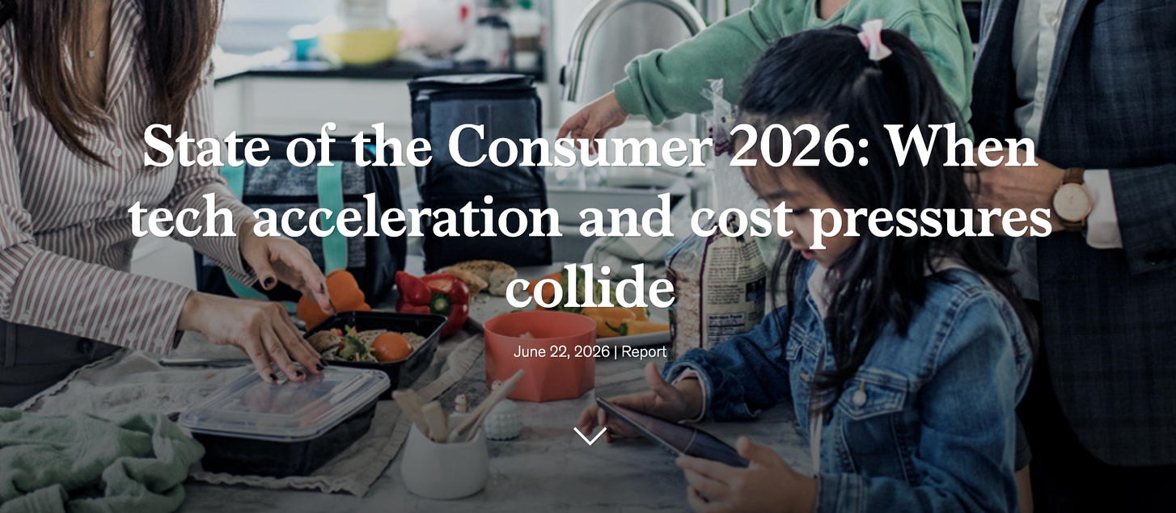
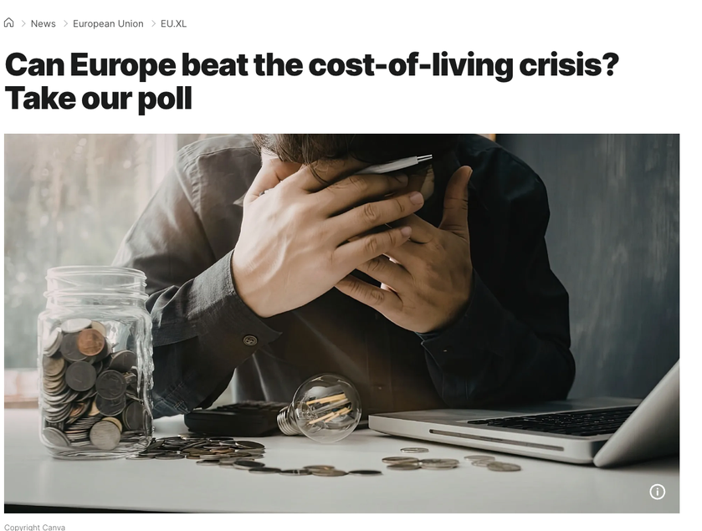
https://www.mckinsey.com/industries/consumer-packaged-goods/our-insights/state-of-consumer#/
1. The new tech-driven path to purchase
2. The health revolution
3. The experience economy
4. The resourceful consumer
Notes:
Today’s lecture is built as five short acts. Each starts with a puzzle you answer before I tell you what happened. Keep a note of which error you think matters most for your project country: that is your exit ticket.
3

Slide 4
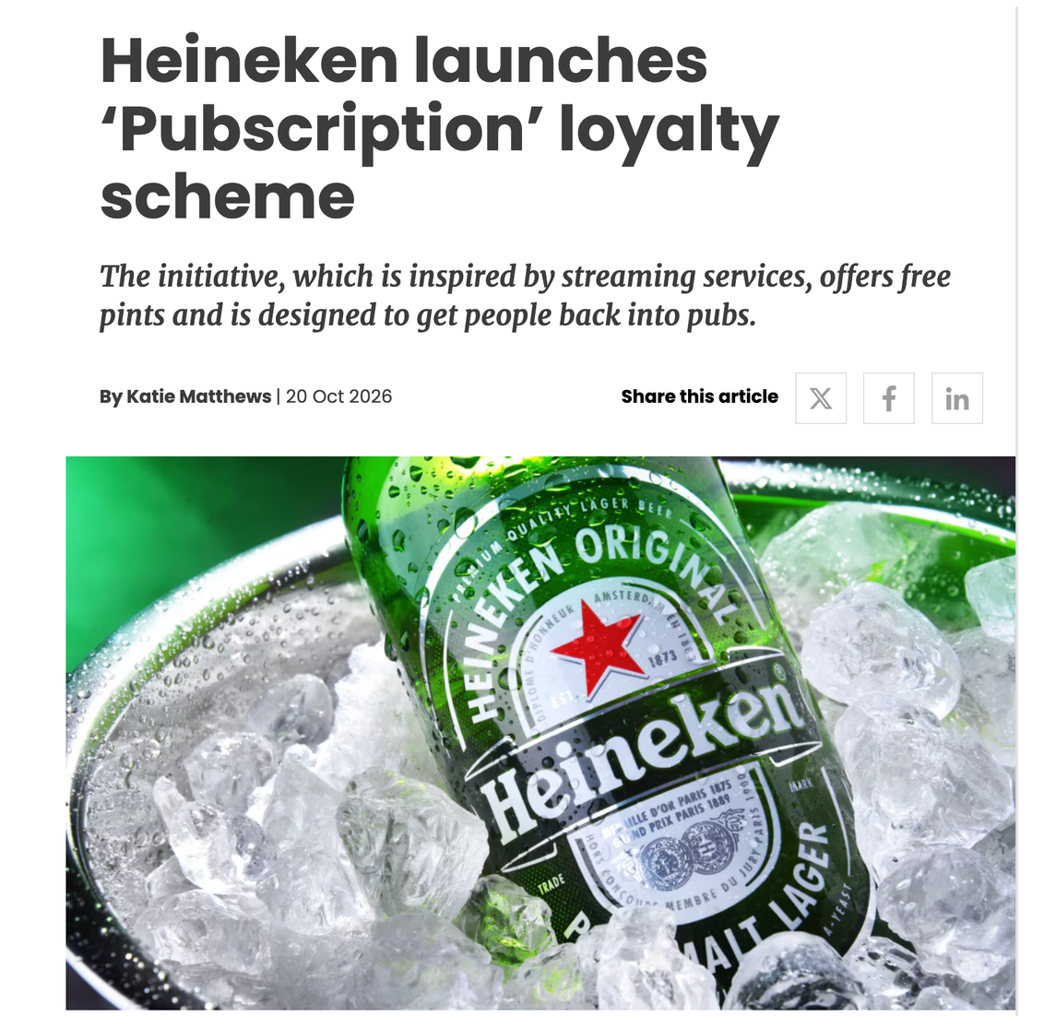
“38% of UK adults say
they would go out
more often”
“We cannot talk about a so-called
safe level of alcohol use.”
WHO, 2023
WHO Europe, 2023 https://www.who.int/europe/news/item/04-01-2023-no-level-of-alcohol-consumption-is-safe-for-our-health
Anderson B.O., Berdzuli N., Ilbawi A. i in. (w tym Ferreira-Borges C.), Health and cancer risks associated with low levels of alcohol consumption, The Lancet Public Health, 2023, t. 8, nr 1, s. e6–e7
https://www.marketingweek.com/heineken-launches-pub-subscription/
Notes:
Today’s lecture is built as five short acts. Each starts with a puzzle you answer before I tell you what happened. Keep a note of which error you think matters most for your project country: that is your exit ticket.
1

Slide 5
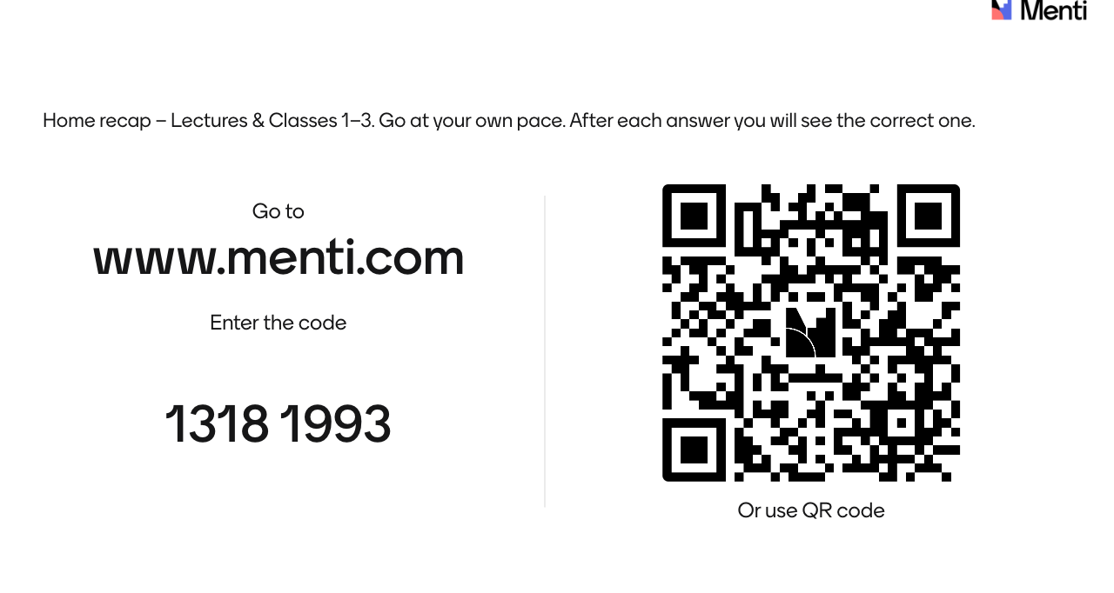
https://www.mentimeter.com/app/presentation/al2xfq1yzt62f7hguzgdxgb8rvu2hjhj/edit
Notes:
Today’s lecture is built as five short acts. Each starts with a puzzle you answer before I tell you what happened. Keep a note of which error you think matters most for your project country: that is your exit ticket.
1

Slide 6

Lecture 4. Marketing research of foreign markets
  What marketing research is and how it starts.
  What makes international research different: single-country vs multicountry research (independent, sequential, simultaneous); emic vs etic approach.
  Methodological traps.
  Research in practice: choosing external suppliers (credibility, competence, cost, capacity); CATI, CAPI, CAWI; secondary data sources (Eurostat, ESOMAR) and their limits.
  Risks and ethical challenges.
Notes:
End on the remedy, not the warnings. Three one-minute stories, then the exit ticket.
5

Slide 7
“
Secondary data is a key source of information in international marketing research due to its ready availability, relatively low cost and usefulness in providing background information relating to a specific country or industry.”
Szymura-Tyc (ed.), 2012
https://elizakania.my.canva.site/international-markering/#page-2
Notes:
End on the remedy, not the warnings. Three one-minute stories, then the exit ticket.
6

Slide 8




Poland before you arrived vs Poland after three years. What did the data miss?
Notes:
End on the remedy, not the warnings. Three one-minute stories, then the exit ticket.
6

Slide 9
International marketing research
Marketing research
International marketing research
“Systematic gathering, recording, and analyzing of data about problems relating to the marketing of goods and services.”
“Research that crosses national borders
and involves respondents and researchers from different countries and cultures.
Most commonly, it involves collecting information and making inferences
about respondents or business activities in two or more countries within the
context of a single research project.”
American Marketing Association, quoted by Onkvisit & Shaw
“Marketing research involves the identification, collection, analysis, dissemination, and use of information for the purpose of improving decision making related to identifying and solving problems in marketing.
Craig & Douglas, quoted by Szymura-Tyc
Szymura-Tyc (ed.)
Notes:
Read the three definitions as a progression: what research does, what it is for, and what makes it international. Szymura-Tyc: research done for any reason other than aiding a decision is of no value, and is wasted unless decision makers accept the results (p. 60); the Whirlpool case in Act 1 shows this. Onkvisit & Shaw open the chapter by saying international research is more difficult and more complex than domestic research (p. 214). Szymura-Tyc also distinguishes single-country and multicountry research (p. 65).
7

Slide 10


Same steps in Warsaw or London
1 · Define the problem
2 · Plan the research
3 · Collect data
4 · Analyse
5 · Report
Isolate the self-reference criterion
Construct equivalence; secondary-data quality; valid instruments; language
Collect relevant data sources
Select, train and supervise field workers
Check inconsistent findings; analysis equivalence
The researcher’s frame of reference; limits of projecting to other cultures
The iceberg principle
“The real problems are below the waterline of observation”
Introduce a new type of frozen cake into the Polish market (decision problem) ⟶ analyse the Polish cake market and find out whether there is demand for new types of frozen cakes (research problem)
Notes:
Szymura-Tyc: whether the research is conducted in Stockholm or in London, the process should follow the same steps (p. 69). The first step is more critical abroad, because an unfamiliar environment clouds the problem definition (pp. 69–70). Bridge: before the five errors, one puzzle shows why the numbers we start from cannot be taken on trust.
8

Slide 11
Research – foundations
Criterion | Types
(a) Nature of the enquiry | Exploratory (explore issue or topic, clarify an unfamiliar market) Descriptive (who, what, how many) Causal (cause and effect, by experiment)
(b) Source of data | Secondary (collected by others, for other purposes – datasets, literature etc) Primary (collected for this project)
(c) Type of data | Qualitative (ideas, quotes, small samples, interviews) Quantitative (structured, representative samples)
(d) Method and (e)mode: ad hoc, continuous | Observation Interview Survey Panels, etc.
(f) Countries covered | Single-country Multi-country: independent, sequential or simultaneous - for instace, causal research is difficult in the international environment (ligistics, price)
Szymura-Tyc (ed.), 2012; see also Onkvisit & Shaw.
Notes:
The first four rows are Szymura-Tyc’s classification (p. 61). The last row combines her single-country vs multicountry distinction with Kumar’s three ways of running multicountry research (pp. 65–66): independent studies by subsidiaries duplicate effort and are hard to compare; sequential research starts in one market and learns before the next, typical of a rolling launch; simultaneous research is the most demanding but the most likely to give comparable results. Onkvisit & Shaw add a warning: simultaneous studies can mislead when seasons or product life-cycle stages differ, e.g. soft drinks in Canada’s winter and Argentina’s summer. Also mention emic vs etic (Szymura-Tyc, p. 66): culture-specific measures vs measures meant to work everywhere; most researchers combine the two.
9

Slide 12
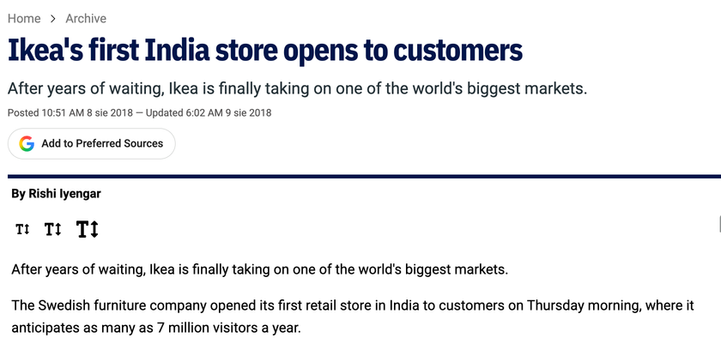
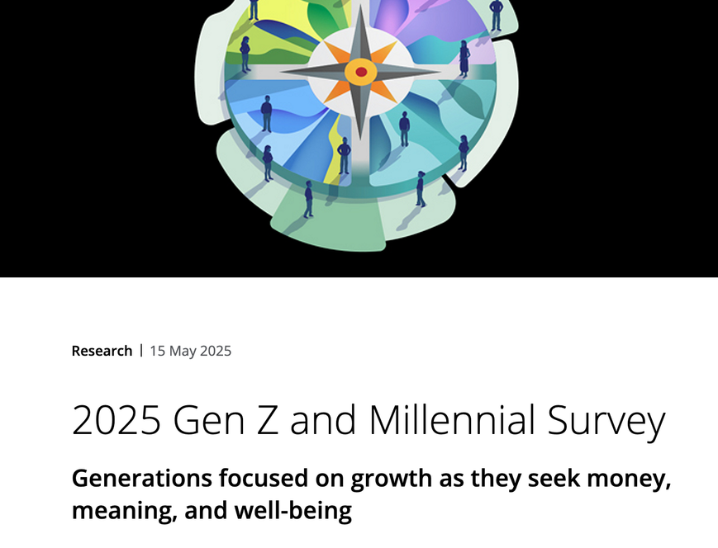
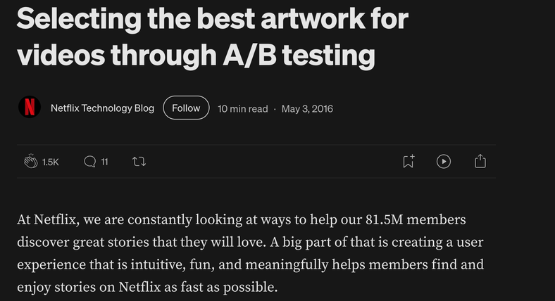
Nature of the enquiry
Exploratory
Descriptive
Causal
When
At the start, when the market or problem is unfamiliar
When we know what we are looking for
When we need to know what drives an outcome
Key question
What is going on here? What don’t we know?
Who? What? When? How? How many?
Does X cause Y?
Aim
Clarify concepts, develop hypotheses, set priorities
Build a picture of a market; identify, describe and count
Determine cause and effect between decision variables (price, advertising) and outcomes (sales)
Typical data
Qualitative, small samples, flexible questions
Quantitative, structured, representative samples
Quantitative; test and control groups, randomly assigned
Main method
Interviews, focus groups, observation
Surveys, secondary data
Experiment (laboratory or natural setting)
Output
Hypotheses and better questions
Numbers and profiles
Evidence of cause and effect
Notes:
The first four rows are Szymura-Tyc’s classification (p. 61). The last row combines her single-country vs multicountry distinction with Kumar’s three ways of running multicountry research (pp. 65–66): independent studies by subsidiaries duplicate effort and are hard to compare; sequential research starts in one market and learns before the next, typical of a rolling launch; simultaneous research is the most demanding but the most likely to give comparable results. Onkvisit & Shaw add a warning: simultaneous studies can mislead when seasons or product life-cycle stages differ, e.g. soft drinks in Canada’s winter and Argentina’s summer. Also mention emic vs etic (Szymura-Tyc, p. 66): culture-specific measures vs measures meant to work everywhere; most researchers combine the two.
10

Slide 13
Guess the type: exploratory, descriptive or causal?
1 · Facebook and your mood
2 · LEGO and the old sneakers
3 · Where young people get news
Researchers reduced the number of either positive or negative stories in the news feeds of 689,003 randomly selected Facebook users for one week. Then they checked what the users posted themselves and whether the emotional states were transferred.
In the early 2000s, LEGO was on the brink. Researchers fanned out across Los Angeles, New York, Chicago, Munich and Hamburg. They made photo diaries, interviewed parents and asked kids to tell them stories. An 11-year-old German boy showed them his most prized possession: a worn-out pair of sneakers. They discovered that kids like complex tasks, not the easy ones.
Every year, the Reuters Institute (University of Oxford) surveys news use in 48 markets, with almost 100,000 online respondents. Interesting finding: in the countries tracked since 2014, TikTok news use rose from 1% in 2020 to 10% in 2025.
C
E
D
Source: PNAS, 2014
Source: Fortune, 2014
Source: Reuters Institute Digital News Report 2025
4 · Booking.com: many versions
5 · Nokia in Uganda
6 · Duolingo’s language map
At any moment Booking.com runs more than 1,000 A/B tests on its live website: a different button colour here, a different urgency message (“booked 4 times in the last 24 hours”) there. Users are split into groups that see different versions.
In 2006 Nokia researchers went to Uganda to understand how people share mobile phones. They found practices nobody at headquarters had imagined, e.g. “Sente”: a phone owner acts as an informal ATM, sending money to the village as airtime.
Every year Duolingo publishes which languages people learn in which countries. In 2024 English was #1 in 135 countries. In China, Japanese came second, and 32% of its learners said they study it just for fun.
C
E
D
Source: Silicon Canals
Source: TED, Jan Chipchase, 2007
Source: Duolingo Language Report 2024
Notes:
ANSWERS
1 Facebook – CAUSAL: random groups, one thing changed (the feed), effect measured. Ethics hook: legal under Facebook's terms, but users did not know they were in an experiment. Causal, yes – but was it OK?
2 LEGO – EXPLORATORY: no idea what to look for; observation and stories produced a new hypothesis (kids want mastery).
3 Reuters – DESCRIPTIVE: survey, numbers, comparison across countries and years; does not tell us WHY young people choose TikTok.
4 Booking.com – CAUSAL: A/B tests are experiments – does change X cause more bookings? Compare with Netflix artwork tests.
5 Nokia – EXPLORATORY: unfamiliar market, on-site observation, unexpected behaviour discovered.
6 Duolingo – DESCRIPTIVE: what, where, what percentage. Trick: data come from the app, not a survey – but nobody changed anything, so it is not causal.
Type labels are our interpretation; the companies do not use these terms.

Slide 14
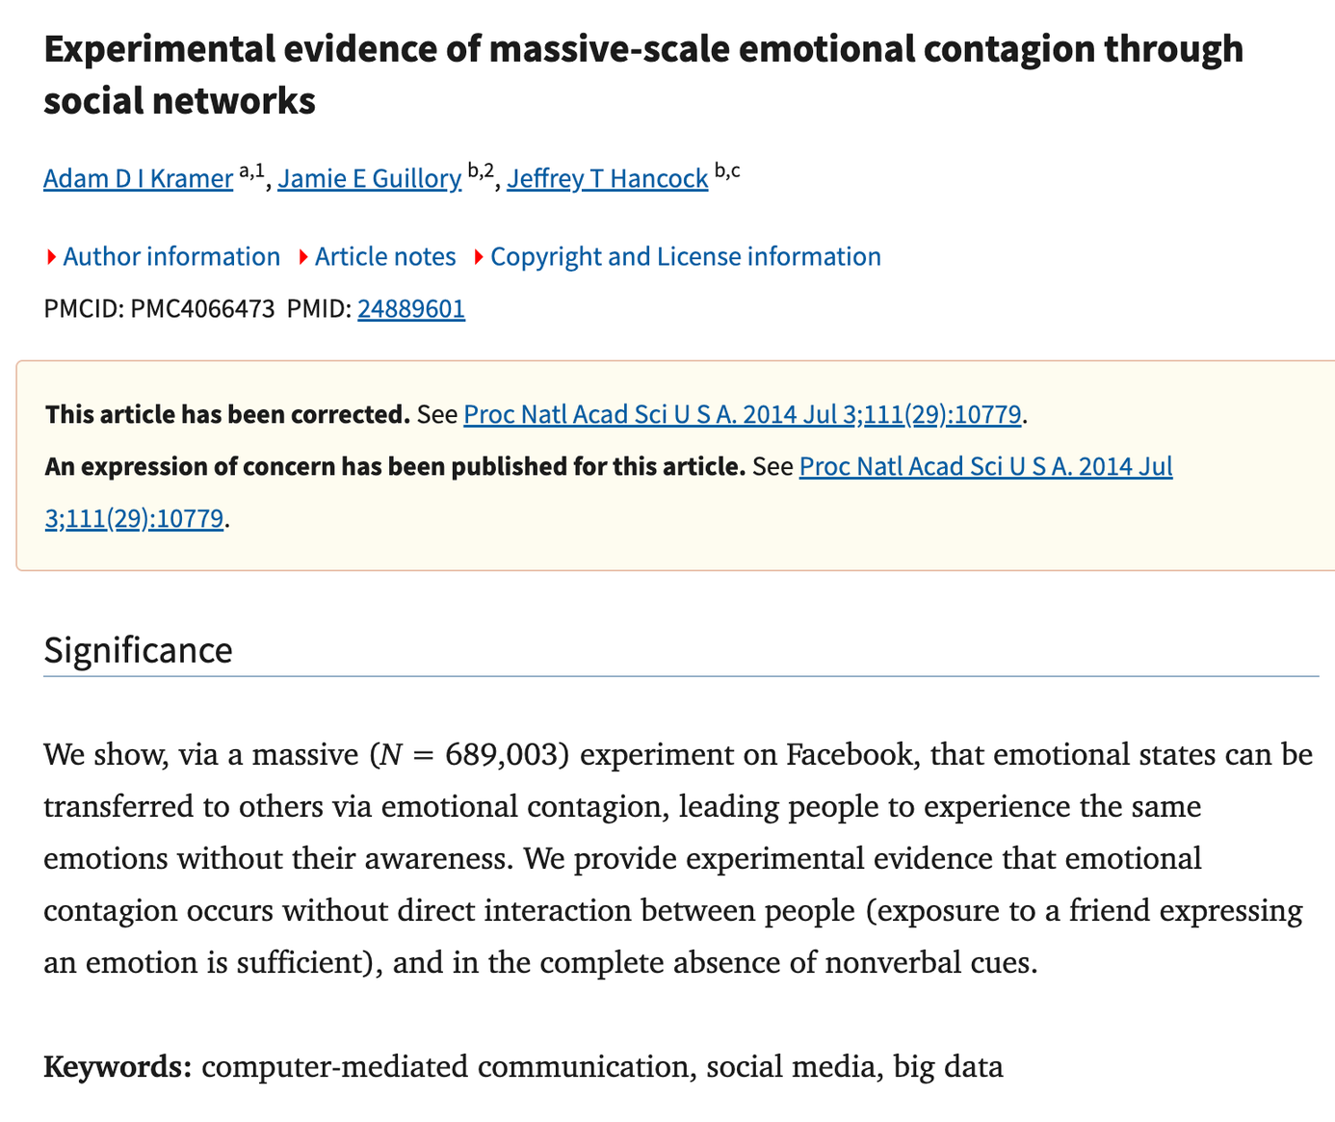
Notes:
ANSWERS
1 Facebook – CAUSAL: random groups, one thing changed (the feed), effect measured. Ethics hook: legal under Facebook's terms, but users did not know they were in an experiment. Causal, yes – but was it OK?
2 LEGO – EXPLORATORY: no idea what to look for; observation and stories produced a new hypothesis (kids want mastery).
3 Reuters – DESCRIPTIVE: survey, numbers, comparison across countries and years; does not tell us WHY young people choose TikTok.
4 Booking.com – CAUSAL: A/B tests are experiments – does change X cause more bookings? Compare with Netflix artwork tests.
5 Nokia – EXPLORATORY: unfamiliar market, on-site observation, unexpected behaviour discovered.
6 Duolingo – DESCRIPTIVE: what, where, what percentage. Trick: data come from the app, not a survey – but nobody changed anything, so it is not causal.
Type labels are our interpretation; the companies do not use these terms.

Slide 15
“
High-quality desk research is an important part of most international market research studies. What is more, a significant increase in the use of secondary data is predicted, and an increasing number of international marketing research problems are likely to be addressed based on secondary data alone”.
Szymura-Tyc (ed.), 2012
Notes:
End on the remedy, not the warnings. Three one-minute stories, then the exit ticket.
6

Slide 16
Source of data: secondary or primary?
Secondary
Primary
Data gathered earlier by someone else and/or for another purpose: company records, governments, trade press, UN agencies, Eurostat. Cheap, quick, often available online.
Data collected specifically for this project, in the field, with trained interviewers or moderators. Tailored to the question, but costly and difficult to collect abroad.
CASE
CASE
Check the definitions before you compare countries. An “urban” area means a locality of 200+ inhabitants in Denmark, but at least 20,000 in Nigeria. In Bermuda and Singapore the whole country counts as urban.
Before opening its first Indian store (Hyderabad, 2018), IKEA visited more than 1,000 Indian homes. What it saw shaped the range: pressure cookers, coconut-fibre mattresses and pans for Indian flatbread.
Source: Onkvisit & Shaw, 2004
Source: CNN via WRAL, 2018
Notes:
Szymura-Tyc (p. 63): primary data are collected for the project at hand; secondary data were gathered by someone else and/or for another purpose. Abroad, secondary data are especially valuable because primary data are costly and difficult; Malhotra & Peterson predict more problems will be solved with secondary data alone.
Onkvisit & Shaw (ch. 8): no research should start without a search for secondary data; evaluate purpose, methodology, definitions and time period. Cross-country data may not be comparable: different collection methods, classifications, units and definitions (the 'urban' example).
IKEA: CNN via WRAL (2018). Sources differ on how long the research lasted (from about 3 years to 12 years of preparation); all agree on 1,000+ home visits.
Bottom line is our illustration: whether data are primary or secondary depends on who uses them and for what.

Slide 17
Denmark counts a place with 200 people as urban. Nigeria needs 20,000.
Always check and compare methodologies.
UN-Habitat (2020), What is a City?

Slide 18
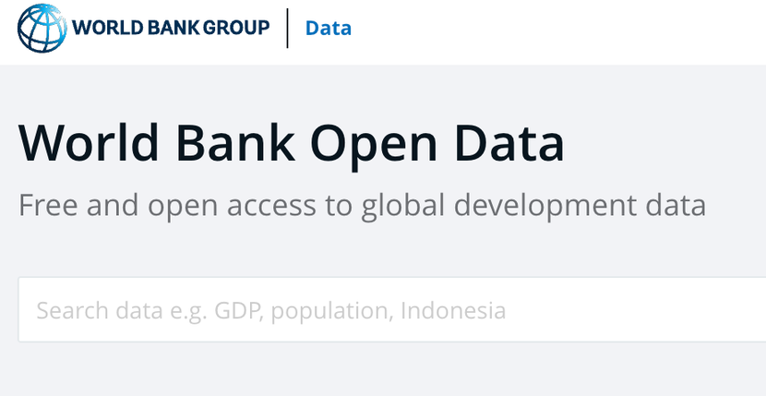




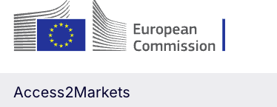

https://elizakania.my.canva.site/international-markering/#page-2
Source of data: secondary or primary?
Notes:
Szymura-Tyc (p. 63): primary data are collected for the project at hand; secondary data were gathered by someone else and/or for another purpose. Abroad, secondary data are especially valuable because primary data are costly and difficult; Malhotra & Peterson predict more problems will be solved with secondary data alone.
Onkvisit & Shaw (ch. 8): no research should start without a search for secondary data; evaluate purpose, methodology, definitions and time period. Cross-country data may not be comparable: different collection methods, classifications, units and definitions (the 'urban' example).
IKEA: CNN via WRAL (2018). Sources differ on how long the research lasted (from about 3 years to 12 years of preparation); all agree on 1,000+ home visits.
Bottom line is our illustration: whether data are primary or secondary depends on who uses them and for what.

Slide 19

Type of data: qualitative or quantitative?
Qualitative
Quantitative
Finds out what is in the consumer’s mind: feelings, thoughts, intentions. Results are ideas and quotes, not statistics. Small samples: interviews, focus groups, observation.
Formalised questions with predetermined answers are put to a large, representative sample. Linked to descriptive and causal designs; the most widely used technique is the survey.
CASE STUDY
CASE
A credit card company entering Eastern Europe started with qualitative research. In Poland, attitudes to debt were shaped by the teaching of the Church – something that did not come up in the neighbouring Czech Republic.
Deloitte’s 2025 Gen Z and Millennial Survey: 23,482 respondents in 44 countries, one online questionnaire. One result: only 6% of Gen Zs make reaching a leadership position their priority.
Source: Deloitte, 2025
Source: Szymura-Tyc, 2012.
Notes:
Szymura-Tyc (pp. 63–64): qualitative research finds out what is in the consumer's mind – feelings, thoughts, intentions, past behaviour; rich description and insight rather than measurement; ideas and quotes, small samples; interviews, focus groups (8–12 people, trained moderator who knows the language and culture), observation, projective techniques. In some countries people avoid discussing feelings in a group – use in-depth interviews. Quantitative: formalised questions, predetermined answers, large representative samples; tied to descriptive and causal designs; survey is the main technique.
Case 3.2 (Brassington & Pettitt, in Szymura-Tyc p. 62): after the qualitative stage dispelled the idea of a homogeneous Eastern Europe, the firm designed a quantitative questionnaire.
Deloitte 2025: 14,751 Gen Zs + 8,731 millennials, 44 countries, online, fieldwork 25 Oct–24 Dec 2024; plus separate one-to-one ethnography-style interviews.

Slide 20


Notes:
Szymura-Tyc (pp. 63–64): qualitative research finds out what is in the consumer's mind – feelings, thoughts, intentions, past behaviour; rich description and insight rather than measurement; ideas and quotes, small samples; interviews, focus groups (8–12 people, trained moderator who knows the language and culture), observation, projective techniques. In some countries people avoid discussing feelings in a group – use in-depth interviews. Quantitative: formalised questions, predetermined answers, large representative samples; tied to descriptive and causal designs; survey is the main technique.
Case 3.2 (Brassington & Pettitt, in Szymura-Tyc p. 62): after the qualitative stage dispelled the idea of a homogeneous Eastern Europe, the firm designed a quantitative questionnaire.
Deloitte 2025: 14,751 Gen Zs + 8,731 millennials, 44 countries, online, fieldwork 25 Oct–24 Dec 2024; plus separate one-to-one ethnography-style interviews.

Slide 21
Mode: ad hoc or continuous?
Ad hoc
Continuous
Designed to address one specific problem, or to understand one issue, at a certain point in time.
Carried out continuously or at regular intervals to monitor change over time in a market or population – most often with a panel representing the target population.
CASE
CASE
Shortly before the November 1998 election, about 30,000 voters in New Haven (USA) were randomly assigned to door-to-door canvassing, mail or phone calls. Canvassing raised turnout substantially, mail slightly, phone calls not at all.
The Standard Eurobarometer has run since 1974: about 1,000 face-to-face interviews per EU country, published twice a year. Most questions are repeated each time, so trends in opinion can be tracked over decades.
Source: Gerber & Green, American Political Science Review, 2000
Source: European Commission
Notes:
Szymura-Tyc (p. 65): ad hoc research addresses a specific problem or a particular issue at a certain point in time; continuous research is performed continuously or at regular intervals to monitor change over time, most commonly with a panel of respondents selected to represent the target population.
Ad hoc case: Gerber & Green (2000), APSR 94(3): ~30,000 registered voters, New Haven, November 1998 – a one-off field experiment (also a causal design).
Continuous case: Standard Eurobarometer, established 1974; ~1,000 face-to-face interviews per member state (Germany ~2,000, Luxembourg ~600); reports twice a year; most questions repeated to measure trends.
Nuance (general knowledge, not checked in a source today): Eurobarometer draws a new sample each wave, so it is continuous but not a panel; a true panel follows the same people over time.
If this slide goes after 'Five methods', the bottom line works as written; otherwise change 'next slide' to 'previous slide'.

Slide 22
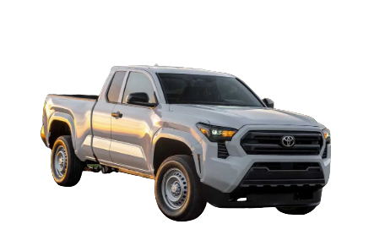
Countries covered: one market or many?
Single-country
Multi · Independent
Multi · Sequential
Multi · Simultaneous
One foreign country, to shape the strategy there.
Subsidiaries run similar studies separately. Effort is duplicated; results are hard to compare.
Start in one market, learn, then move on. Typical of a rolling launch; costs are spread over time.
Several countries at once. The most demanding – and the most likely to give comparable results.
CASE
ILLUSTRATION
ILLUSTRATION
CASE
Toyota’s Japanese planners doubted a big V8 pickup for the US – until they saw rows of full-size pickups at a Dallas Cowboys game. Result: the Toyota Tundra.
A brand’s French and German subsidiaries each measure awareness with their own questionnaire. Head office cannot compare the numbers.
Our frozen cakes: research and launch in Poland first, fix what went wrong, then study Czechia and Slovakia.
Deloitte 2025: the same online questionnaire in 44 countries, fieldwork October–December 2024.
Onkvisit & Shaw
Notes:
Szymura-Tyc (pp. 65–66, after Kumar 2000): single-country research is conducted in one foreign country to help formulate and implement strategy there. Multicountry research can be: independent (subsidiaries do similar research separately – duplication, hard to compare); sequential (start in one market, spread to others, learn along the way; typical of a rolling launch; costs spread over time); simultaneous (several markets at once – most complex, toughest test of the research supplier, most likely to give comparable results).
Cases: Toyota Tundra – Onkvisit & Shaw p. 214 (source: Business Week, 2002). Independent and sequential cards are illustrations written for this slide, not real company cases; the sequential one builds on the book's frozen-cake example (p. 61). Deloitte 2025: 23,482 respondents, 44 countries, online, fieldwork 25 Oct–24 Dec 2024.
Seasons warning: Onkvisit & Shaw, p. 229 (simultaneous research can mislead when seasons or product life-cycle stages differ).

Slide 23
Five methods, and what changes abroad
Method | What it is | Challenges abroad
Desk research | Secondary data: company records, governments, trade press, UN agencies, IMF, Eurostat, ILO, etc | Usually the first step: cheap and quick, but check availability, accuracy, comparability and age
Focus groups and/or in-depth interviews | Qualitative: 8–12 people with a trained moderator, or one-to-one | The moderator must know the language and culture; where people avoid discussing feelings in a group or one to one interview
Survey | Structured questionnaire: in person, phone, mail or online | The usual mode differs by country, e.g. 77% of interviews face to face in Portugal
Observation | Watching what people do instead of asking | More objective, no interviewer influence
Experiment | Test and control groups, assigned at random, lab or controlled environment | Hard across countries: control groups differ, so effects are hard to attribute
Notes:
Onkvisit & Shaw name two principal methods of primary data collection: observation and survey questions (p. 221). Szymura-Tyc adds qualitative interviews and experiments, and stresses that secondary data are what the international researcher is interested in above all, because primary data abroad are costly and difficult (p. 63). A real project combines methods, e.g. a literature review, a focus group and a survey (p. 61). One example per method, all from the books: the credit-card company’s qualitative study in Eastern Europe (Szymura-Tyc, Case 3.2, p. 62; told in Act 1); Honda’s executive observing families in Denver before the Acura MDX (Onkvisit & Shaw, p. 221; told in Act 2). Survey modes come back in Act 2, secondary data in Act 4.
11

Slide 24

Methodologies
CAWI (online)
CATI (telephone)
CAPI (face to face)
The usual mode differs by country – e.g. 77% of interviews were face to face in Portugal.
Computer-Assisted Web Interviewing
Computer-Assisted Telephone Interviewing
Reaches only people who have a phone and pick up.
Computer-Assisted Personal Interviewing
Reaches only people with internet access.
Sometimes the only way to reach rural
or older respondents – but slower and more expensive.
Who disappears from your data if you choose the cheapest method?
Notes:
Onkvisit & Shaw name two principal methods of primary data collection: observation and survey questions (p. 221). Szymura-Tyc adds qualitative interviews and experiments, and stresses that secondary data are what the international researcher is interested in above all, because primary data abroad are costly and difficult (p. 63). A real project combines methods, e.g. a literature review, a focus group and a survey (p. 61). One example per method, all from the books: the credit-card company’s qualitative study in Eastern Europe (Szymura-Tyc, Case 3.2, p. 62; told in Act 1); Honda’s executive observing families in Denver before the Acura MDX (Onkvisit & Shaw, p. 221; told in Act 2). Survey modes come back in Act 2, secondary data in Act 4.
11

Slide 25
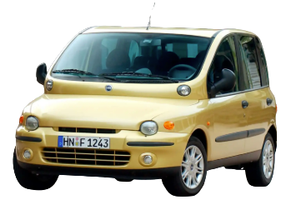
Notes:
Onkvisit & Shaw name two principal methods of primary data collection: observation and survey questions (p. 221). Szymura-Tyc adds qualitative interviews and experiments, and stresses that secondary data are what the international researcher is interested in above all, because primary data abroad are costly and difficult (p. 63). A real project combines methods, e.g. a literature review, a focus group and a survey (p. 61). One example per method, all from the books: the credit-card company’s qualitative study in Eastern Europe (Szymura-Tyc, Case 3.2, p. 62; told in Act 1); Honda’s executive observing families in Denver before the Acura MDX (Onkvisit & Shaw, p. 221; told in Act 2). Survey modes come back in Act 2, secondary data in Act 4.
11

Slide 26
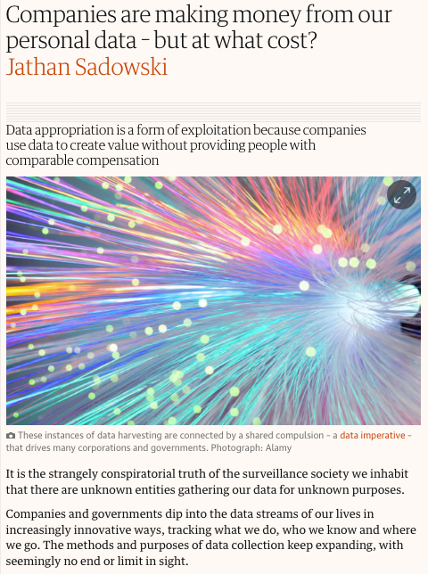
1. How your data is collected
Companies gather massive amounts of personal information through everyday digital and physical interactions:
  Digital tracking: Web browsers use cookies, tracking pixels, and digital fingerprinting to monitor what you click, search, and view.
  App activity: Smartphone apps track your exact GPS location, contact lists, microphone use, and usage habits.
  Transactions & loyalty programs: Retail stores, credit card companies, and online checkouts record your purchase history, preferred brands, and spending patterns.
  Public & Commercial records: Public registries, social media profiles, and previous data breaches are scraped and combined to build detailed personal profiles.
2. How data is processed and sold
Rather than selling a raw list with your name and home address attached directly to every buyer, companies monetise data in two main ways:
  Targeted advertising auctions (The Duopoly Model): Tech giants like Google and Meta don't usually hand your raw profile over to an advertiser. Instead, they let corporations buy access to audiences. An advertiser says, "Show this shoe ad to 25-year-olds who like hiking," and the platform targets you automatically.
  Data brokers: Specialised companies like Acxiom, Equifax, and various shadow brokers harvest, clean, and compile data into massive databases. They sell or license these categorised lists (containing financial habits, health inferences, or lifestyle traits) via subscriptions to insurance firms, banks, hedge funds, and marketers.
3. How you can limit data sales
  Opt-Out via Privacy Tools
  Tighten device & Browser settings
  Limit Loyalty Programs
Notes:
Onkvisit & Shaw name two principal methods of primary data collection: observation and survey questions (p. 221). Szymura-Tyc adds qualitative interviews and experiments, and stresses that secondary data are what the international researcher is interested in above all, because primary data abroad are costly and difficult (p. 63). A real project combines methods, e.g. a literature review, a focus group and a survey (p. 61). One example per method, all from the books: the credit-card company’s qualitative study in Eastern Europe (Szymura-Tyc, Case 3.2, p. 62; told in Act 1); Honda’s executive observing families in Denver before the Acura MDX (Onkvisit & Shaw, p. 221; told in Act 2). Survey modes come back in Act 2, secondary data in Act 4.
11

Slide 27
Ethical considerations (constructing research)
1 · Duty of care
2 · Vulnerable people
3 · Privacy rules differ
Research must not harm participants. Say who is asking and why; people can refuse or stop at any time.
Children, the elderly and people with low literacy may not be able to give informed consent. They need extra protection.
In the EU privacy is a fundamental right (today: GDPR). France banned collecting data on trade-union membership; Germany's rules are among the strictest. UK - GDPR
4 · Collect only what you need
5 · Respondents' safety
6 · Research is not selling
Personal data only for a stated purpose, never reused in an incompatible way. Anonymise before sharing across borders.
Questions about politics, media or religion can put respondents at risk. Check RSF and Freedom House; guarantee anonymity.
Never disguise sales as a survey; be honest with clients about methods and limits. Public trust in research is a shared asset.
ICC/ESOMAR Code (2016; rev. 2025); Onkvisit & Shaw, 2004, pp. 236, 451; Schlegelmilch, 2022, ch. 13; Szymura-Tyc (ed.), 2012, p. 78
Notes:
Sources per card.
1, 2, 4, 6: ICC/ESOMAR International Code (2016 edition articles: duty of care; children, young people and other vulnerable individuals; data minimisation; primary data collection; use of secondary data; data protection and privacy; transparency; publishing findings). The Code was revised in September 2025 (ICC press page, 29 Sept 2025); the revision stresses privacy, duty of care, transparency, professional responsibility and compliance with the law, and addresses AI and synthetic data.
2: Schlegelmilch (2022, ch. 13): vulnerable consumers have an impaired ability to give informed consent; in developing countries illiteracy and low education make this more common.
3: Onkvisit & Shaw (2004, p. 451): no pan-European law at the time, each country's law must be analysed; France – illegal to collect data on trade-union membership; Germany – among the most restrictive; in Europe privacy is a fundamental human right. NOTE: the book predates the GDPR (in force since 2018), so the 'today: GDPR' part is our update, not the book's.
4: Onkvisit & Shaw (p. 236, Safe Harbor principles): personal information must be relevant to its purpose and not processed in a way incompatible with the purpose for which it was collected.
5: our own application of the RSF / Freedom House data (pages 2–4 of the course website); not a quotation from the textbooks.
6: Szymura-Tyc (p. 78): the Polish industry programme 'Your opinion matters' (OFBOR, www.twoja-opinia.pl) to build respondents' trust; willingness to take part is culture-bound (e.g. phone interviews with Russian executives are hard – Babińska & Nizielska, 2009).
Link back to the Facebook emotional-contagion experiment: legal under the terms of service does not mean ethical.
Code link: https://iccwbo.org/publication/iccesomar-international-code-market-opinion-social-research-data-analytics/

Slide 28

Ethical challenges (general)
  Rural vs urban
  Urban classes
  Representative probe (WEIRD)
  Methodologies
  Bias
96% of subjects in top psychology journals (2003–2007) came from Western countries with 12% of the world’s population (Arnett 2008; Henrich et al. 2010). Conclusions about “people” were drawn from WEIRD students – a sampling equivalence problem.
  W – “Western”
  E – Educated
  I – Industrialised
  R – Rich
  D – Democratic
Notes:
Onkvisit & Shaw name two principal methods of primary data collection: observation and survey questions (p. 221). Szymura-Tyc adds qualitative interviews and experiments, and stresses that secondary data are what the international researcher is interested in above all, because primary data abroad are costly and difficult (p. 63). A real project combines methods, e.g. a literature review, a focus group and a survey (p. 61). One example per method, all from the books: the credit-card company’s qualitative study in Eastern Europe (Szymura-Tyc, Case 3.2, p. 62; told in Act 1); Honda’s executive observing families in Denver before the Acura MDX (Onkvisit & Shaw, p. 221; told in Act 2). Survey modes come back in Act 2, secondary data in Act 4.
11

Slide 29
You are sizing a market in a country whose official statistics you do not trust.
How do you check its GDP?
Notes:
Take the vote. Option C will get laughs; ask the few who chose it what they meant. Hint if needed: from space, economic activity is visible as light.
13

Slide 30
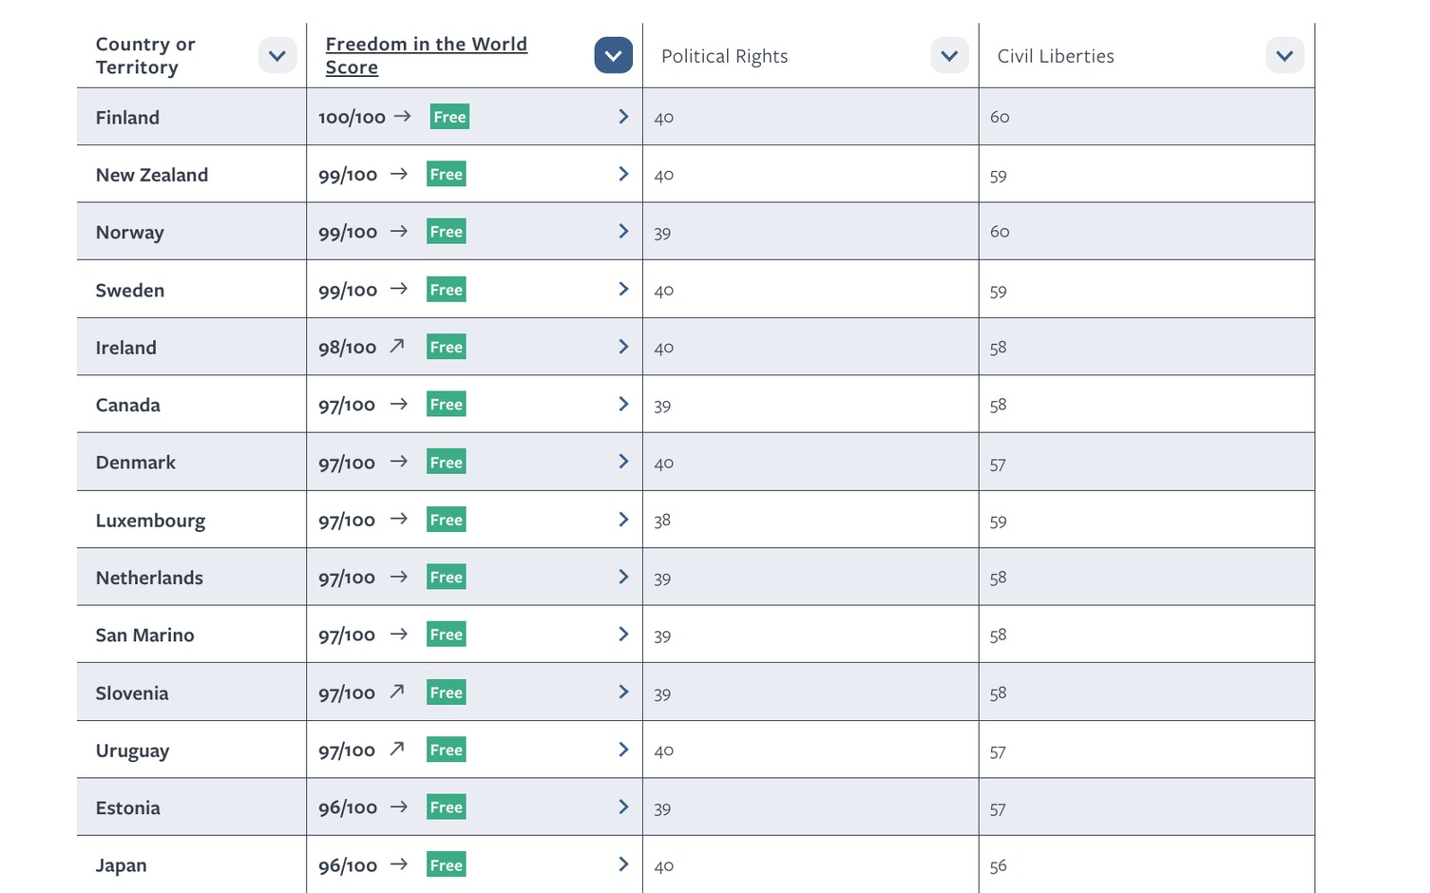
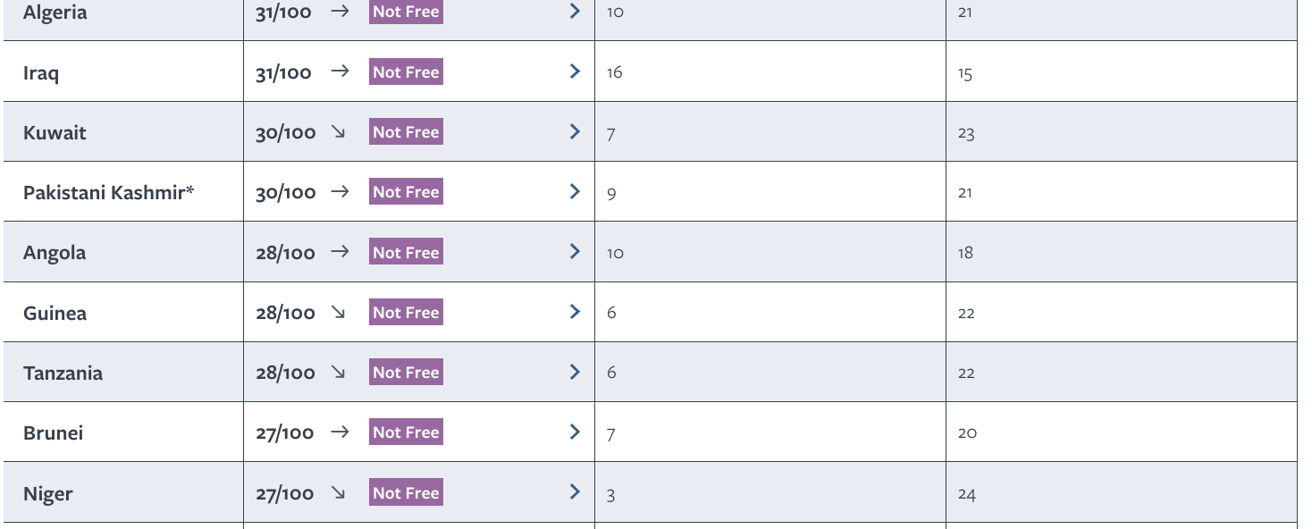
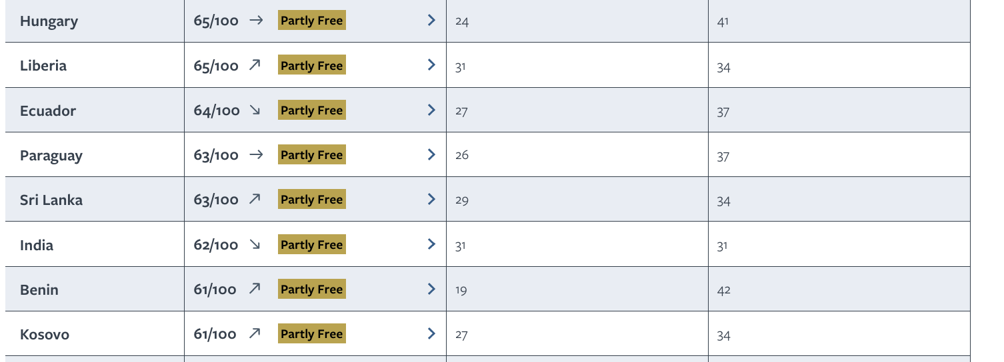
Notes:
Take the vote. Option C will get laughs; ask the few who chose it what they meant. Hint if needed: from space, economic activity is visible as light.
15

Slide 31

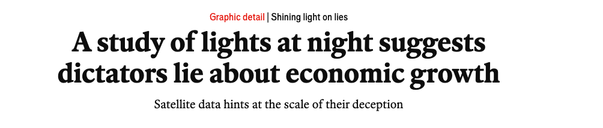
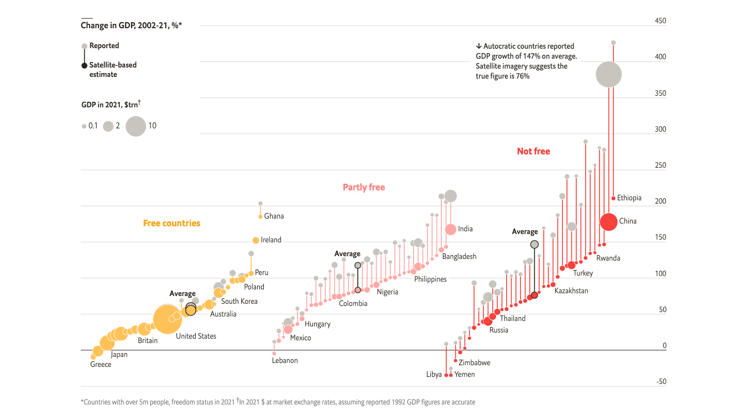
Key sources
  Henderson, J. V., A. Storeygard, and D. N. Weil. 2012. Measuring economic growth from outer space. American Economic Review 102(2): 994–1,028, doi:10.1257/aer.102.2.994
  Leitzell, K. (2020, December 28). Prosperity shining. NASA Earthdata. https://www.earthdata.nasa.gov/news/feature-articles/prosperity-shining
  Martínez, L. R. (2021). How much should we trust the dictator’s GDP growth estimates? (BFI Working Paper No. 2021-78). Becker Friedman Institute for Economics, University of Chicago. https://bfi.uchicago.edu/wp-content/uploads/2021/07/BFI_WP_2021-78.pdf
  The Economist. (2022, September 29). A study of lights at night suggests dictators lie about economic growth. The Economist (Graphic detail). https://www.economist.com/graphic-detail/2022/09/29/a-study-of-lights-at-night-suggests-dictators-lie-about-economic-growth
  Freedom House: https://freedomhouse.org/country/scores
≈35%
by which autocracies overstate yearly GDP growth
Based on Freedom House methodology
Notes:
Take the vote. Option C will get laughs; ask the few who chose it what they meant. Hint if needed: from space, economic activity is visible as light.
14

Slide 32
Research triangulation
Research triangulation is the practice of using multiple sources, methods, investigators, or theories to study the same phenomenon.
1 · DATA
2 · INVESTIGATOR
3 · THEORY
4 · METHOD
  Time triangulation: Collecting data at different points in time (such as pre-program, mid-program, and post-program) to see if findings remain stable.
  Space (Location) triangulation: Gathering data from multiple physical locations or settings.
  Person (Group/Stakeholder) triangulation: Involving different groups of people, such as mixing perspectives from customers, employees, and managers
More than one researcher collects and interprets
Read the results through more than one lens
Combine methods: what people say and what they do
EXAMPLE
EXAMPLE
EXAMPLE
A local and a foreign researcher read the same interviews: a check on the self-reference criterion.
UN HDI (health, education, income) vs Augmented HDI, which adds liberal democracy: rich but unfree countries score lower.
Survey + home visits (IKEA, India). YouGov, 2017: its online-panel model called a hung parliament when most UK polls did not.
Data triangulation is a research strategy that uses multiple data sources to check and confirm findings. By looking at a problem from more than one angle, you reduce single-source bias and increase the validity and credibility of your research.
Notes:
Take the vote. Option C will get laughs; ask the few who chose it what they meant. Hint if needed: from space, economic activity is visible as light.
13

Slide 33
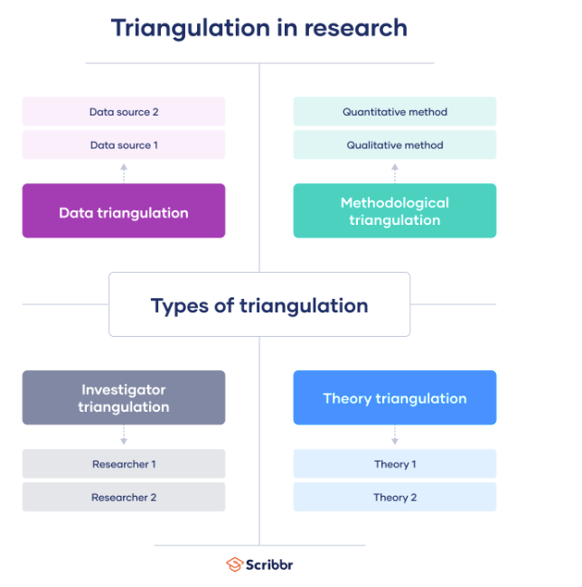
Notes:
Take the vote. Option C will get laughs; ask the few who chose it what they meant. Hint if needed: from space, economic activity is visible as light.
13

Slide 34
https://elizakania.my.canva.site/international-markering/#page-2
Source of data: secondary or primary?
Notes:
Szymura-Tyc (p. 63): primary data are collected for the project at hand; secondary data were gathered by someone else and/or for another purpose. Abroad, secondary data are especially valuable because primary data are costly and difficult; Malhotra & Peterson predict more problems will be solved with secondary data alone.
Onkvisit & Shaw (ch. 8): no research should start without a search for secondary data; evaluate purpose, methodology, definitions and time period. Cross-country data may not be comparable: different collection methods, classifications, units and definitions (the 'urban' example).
IKEA: CNN via WRAL (2018). Sources differ on how long the research lasted (from about 3 years to 12 years of preparation); all agree on 1,000+ home visits.
Bottom line is our illustration: whether data are primary or secondary depends on who uses them and for what.

Slide 35
INTERNATIONAL MARKETING 2026/27 · LECTURE 5-6 · 5 NOVEMBER
Differentiation of
buyers' behaviour in international markets

Slide 36
LECTRUE 5-6 Differentiation of buyers' behaviour in international markets
  Differentiation of buyers' behaviour on international markets (II): segmentation and positioning
  Macro- and micro-segmentation; criteria for good segments.
  Segmentation bases, including big data; transnational segments; targeting strategies.
  Positioning, local and global.
  Special guest: Kinga Kaźmierczak (Unilever, PM for digital twins project)
  Check-in: The essay assignment.
  Consumer behavior in the international context
  Culture as the source of differences in buying behaviour: definitions (Hofstede; Keegan & Green); characteristics of culture; influence on consumption and communication
  Frameworks for comparing cultures
  Psychological and social influences
  The country dimension: consumer ethnocentrism, the country-of-origin effect, and “the myth of converging values”
  Risks and ethical challenges

Slide 37


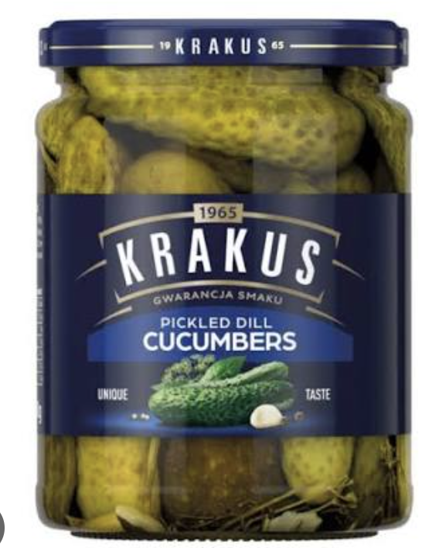

Slide 38
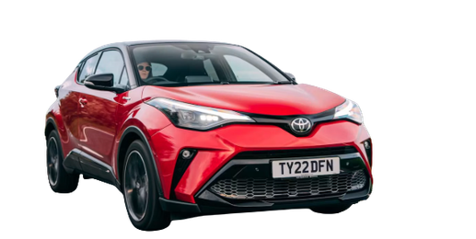
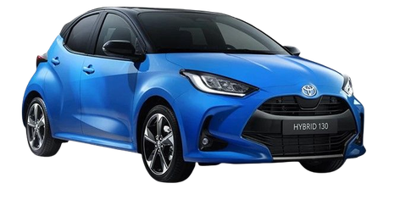
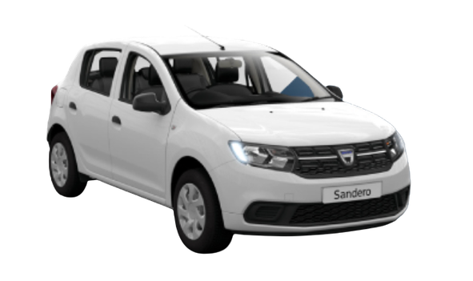

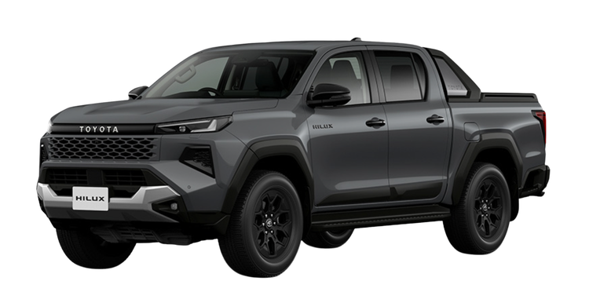
Market segmentation – what does it mean?
Notes:
Toyota = serves many segments (close to full market coverage, incl. Lexus for luxury). Dacia = concentrates on value-seeking, price-sensitive buyers; now moving into the larger C-segment SUV market. Irish Times, 23 Apr 2025: CEO Denis Le Vot says the average C-SUV transaction price rose from €29,000 in 2019 to €38,000 in 2024 – leaving room for a cheaper offer; Dacia asked German buyers which equipment they could do without. Ferrari = niche: one narrow, wealthy segment. Ask students: which segment would you add, and why? Source: https://www.irishtimes.com/motors/2025/04/23/dacias-boss-wants-to-move-upmarket-but-without-a-big-shift-in-prices

Slide 39
BRAND A
BRAND B
BRAND C
Toyota
Dacia
Ferrari
A very wide range: small city cars, family hybrids, SUVs and pickup trucks – plus luxury models under the Lexus brand.
Simple, robust cars with only the essential equipment, priced well below most competitors.
High-performance sports cars made in limited numbers – exclusivity and prestige are part of the product.
→ Serves many segments
→ Focuses on value seekers
→ A narrow, wealthy niche
Notes:
Toyota = serves many segments (close to full market coverage, incl. Lexus for luxury). Dacia = concentrates on value-seeking, price-sensitive buyers; now moving into the larger C-segment SUV market. Irish Times, 23 Apr 2025: CEO Denis Le Vot says the average C-SUV transaction price rose from €29,000 in 2019 to €38,000 in 2024 – leaving room for a cheaper offer; Dacia asked German buyers which equipment they could do without. Ferrari = niche: one narrow, wealthy segment. Ask students: which segment would you add, and why? Source: https://www.irishtimes.com/motors/2025/04/23/dacias-boss-wants-to-move-upmarket-but-without-a-big-shift-in-prices

Slide 40
Segmentation in the international context is the process of identifying specific segments – whether they be country groups or individual consumer groups of potential customers with homogeneous attributes who are likely to exhibit similar responses to a company’s marketing mix.

Slide 41
What is market segmentation?
To make a long story short: Dividing the whole market into groups of clients with similar needs, behaviour and motivations, so the company can decide whom it is going to serve.
STEP 1 · SEGMENT
STEP 2 · EVALUATE
STEP 3 · TARGET
Divide
Assess
Choose
Split the market into groups of clients who share similar needs, buying behaviour and motivations.
Check which segments offer distinctive market opportunities: size, competition, fit with the company.
Serve all potential clients or concentrate on one or more segments within the market.
Source: Babińska, D. (2012), ch. 4 in Szymura-Tyc, M. (ed.).
Notes:
Segmentation = divide the market into groups with similar needs, behaviour and motivations. Targeting = evaluate segments for distinctive market opportunities and choose whom to serve (all clients, or one or more segments). Formal definition (Keegan 1999, p. 198, cited in Babińska 2012, p. 82): segmentation in the international context is identifying segments – country groups or consumer groups – with homogeneous attributes likely to respond similarly to the marketing mix. Next: example with three car brands.

Slide 42

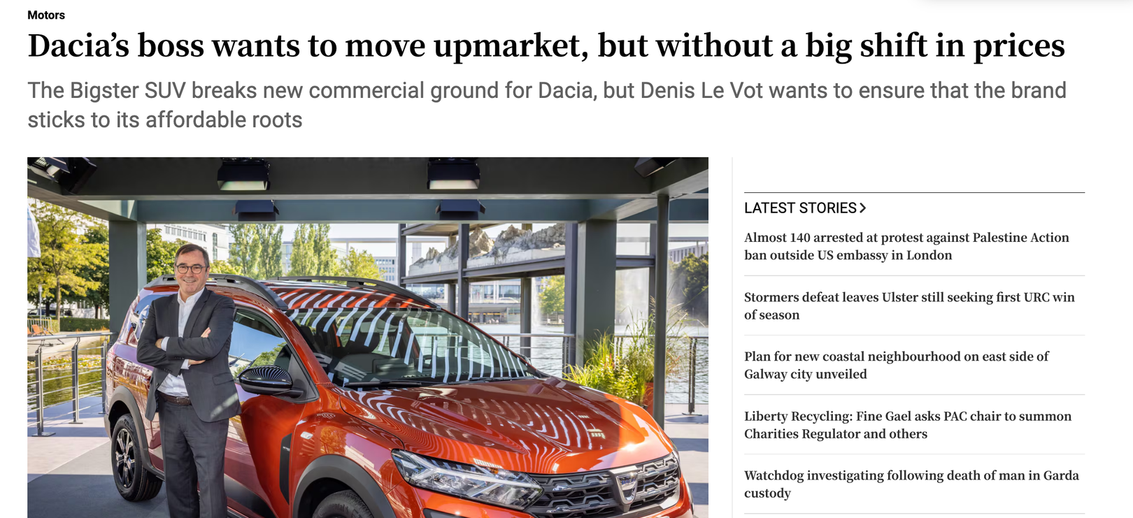
Notes:
Lecture 5 (5 November). Differentiation of consumers' behaviour on international markets (I): culture. Key reading: Szymura-Tyc (ed.) (2012), ch. 2, pp. 45–58. Supporting: Onkvisit & Shaw (2004), ch. 6–7.

Slide 43
Segments, targets
and positions

Slide 44
TRADITIONAL: GROUP COUNTRIES
Macro-level geographic, political, economic and cultural data are used to put similar countries into one segment.
THE PROBLEM?
It shows which countries to target, but not which consumers will respond. Differences within a country are ignored.
MODERN: INTER-MARKET (CROSS-NATIONAL) SEGMENTATION
Group consumers with similar needs in different countries, ignoring or rather not prioritising national borders.
VERY MODERN: By using/buying big data
Example: young urban professionals in Warsaw, Madrid and Stockholm can form one segment – sometimes closer to each other than to rural consumers in their own country.
Notes:
Story in 3 steps: (1) Traditional approach: group countries by macro data (geography, politics, economy, culture). (2) Problem: tells us WHICH COUNTRIES, not WHICH CONSUMERS will respond; within-country heterogeneity is ignored, although it is the very basis of domestic segmentation (Hofstede, Steenkamp, Wedel 1999). (3) Modern approach: inter-market / cross-national consumer segmentation – group consumers by similar needs across borders. Table 4.1 (Samli 1995): Traditional = assumes heterogeneity between countries, focuses on macro-level differences, segments national markets, within-country micro segments get minor priority. Modern = assumes segments that transcend borders, acknowledges within-country differences, focuses on micro-level values and consumption patterns, groups micro markets within or between countries, micro segments based on consumer behaviour get high priority. Source: Babińska (2012), p. 82.

Slide 45
TRADITIONAL PERSPECTIVE (MACRO)
MODERN PERSPECTIVE (MICRO)
Start from countries
Start from consumers
• Assumes countries differ from each other
• Focuses on macro-level differences
• Segments national markets
• Micro segments within a country: low priority
• Assumes segments that cross national borders
• Recognises differences within each country
• Focuses on micro-level values and consumption patterns
• Groups micro markets within or between countries
• Micro segments based on consumer behaviour: high priority
EXAMPLE
EXAMPLE
Car makers often run Germany, Austria and Switzerland as one “DACH” block: one language, high incomes. The segment = a group of countries.
Dacia targets drivers who want the essentials at a fair price – in every country. Sandero: Europe’s best-selling car to private buyers since 2017.
Source: Table 4.1 after Samli (1995), in Babińska (2012)
Notes:
Same industry, two logics. LEFT (traditional): many car companies organise Germany, Austria and Switzerland as one 'DACH' region – e.g. Ford has a Managing Director for Germany, Austria and Switzerland; Maserati and Nissan Centre Europe also run DACH units. Logic: shared language, similar high incomes, similar regulations → countries grouped by macro data. Caveat: this is an organisational/regional grouping – a good illustration of 'start from countries', not proof of a specific segmentation study. RIGHT (modern): Dacia defines its customer by need, not by country – buyers who want 'essentials' and value for money. Sandero has been the best-selling car to private customers in Europe since 2017 and Europe's best-selling car across all channels in 2024 and 2025 (CAR Magazine, Jan 2026). In 2025 Dacia was No. 2 brand in Europe for retail sales (7.9% share). Irish Times (23 Apr 2025): CEO Denis Le Vot – 84% of buyers of the new C-segment model are 'conquest' customers (never owned Dacia/Renault); Dacia asked German buyers which equipment they could do without. Discussion: is a price-conscious driver in Germany more similar to one in Spain or to a BMW buyer next door? Sources: https://www.carmagazine.co.uk/car-news/industry-news/dacia/2025-sales/ ; https://www.irishtimes.com/motors/2025/04/23/dacias-boss-wants-to-move-upmarket-but-without-a-big-shift-in-prices

Slide 46
What data sources?
Sort the free data sources from our course website: do they describe countries – or consumers?
Start from countries
Start from consumers
World Bank Open Data
World Values Survey
Freedom House
Eurobarometer
Hofstede scores
Eurostat
Reuters News Report
RSF Press Index
Deloitte Gen Z Survey
IMF Outlook
Gender Gap (WEF)
DataReportal

Slide 47
What data sources?
Start from countries
Start from consumers
World Bank Open Data
Freedom House
IMF Outlook
Eurobarometer
World Values Survey
RSF Press Index
Eurostat
Gender Gap (WEF)
Reuters News Report
Deloitte Gen Z Survey
DataReportal
Hofstede scores

Slide 48
Assessing new segments –six tests a segment must pass
MEASURABILITY
SUBSTANTIALITY
STABILITY
Can we size it: numbers, purchasing power, preferences?
Is it large and profitable enough, and is it growing?
Will it still be there as preferences and channels change?
ACCESSIBILITY
ACTIONABILITY
DIFFERENTIAL RESPONSE
Can we reach it: language, media, an open market?
Does it respond to our mix?
Does it (our target group) react differently?
Data check: in Europe population statistics are easy; culture-related data (preferences, benefits sought) are the hard part.
Source: Szymura-Tyc (ed.) (2012), Schlegelmilch (2022).

Slide 49
Source of data: secondary or primary?
Notes:
Szymura-Tyc (p. 63): primary data are collected for the project at hand; secondary data were gathered by someone else and/or for another purpose. Abroad, secondary data are especially valuable because primary data are costly and difficult; Malhotra & Peterson predict more problems will be solved with secondary data alone.
Onkvisit & Shaw (ch. 8): no research should start without a search for secondary data; evaluate purpose, methodology, definitions and time period. Cross-country data may not be comparable: different collection methods, classifications, units and definitions (the 'urban' example).
IKEA: CNN via WRAL (2018). Sources differ on how long the research lasted (from about 3 years to 12 years of preparation); all agree on 1,000+ home visits.
Bottom line is our illustration: whether data are primary or secondary depends on who uses them and for what.

Slide 50
MEASURABILIY
A company wants to sell halal food in France.
Can we size it: numbers, purchasing power, preferences?
  Are population statistics and economic data reliable?
  Are consumers accessible for data collection?
The national census will not help, because it does not ask about religion. The company therefore has to turn to academic surveys such as TeO2, in which around 10% of adults aged 18–59 in metropolitan France describe themselves as Muslim. Not easy to obtain data, small samples.
  Le Figaro (2011), France, comment est évalué le nombre de musulmans
  NPR via KPBS (2015): In France, young Muslims often straddle two worlds
  INSEE: Dossier de presse, Recensement 2026
  INSEE (2023), Immigrés et descendants d’immigrés en France, Insee Références, chapter on religion (TeO2 data: Muslims are 10% of the population of metropolitan France aged 18–59; religion is not collected in the census). insee.fr

Slide 51

What share of the EU population was aged 65 or over on 1 January 2025?
A About 1 in 10 (12%)
B About 1 in 5 (22%)
C About 1 in 3 (32%)
D About 2 in 5 (42%)

Slide 52
SUBSTANTIALITY · PROJECTED
What share of the EU population is projected to be
aged 65 or over in 2050?
A About 1 in 5 (22%)
B About 1 in 4 (27%)
C About 1 in 3 (30%)
D About 1 in 2 (50%)

Slide 53
SUBSTANTIALITY
Europe’s “silver” consumers: large and growing.
Is it large and profitable enough, and is it growing?
  What is the segment’s growth potential?
  What is the projected per capita income in the following 10 years?
Is it large and profitable enough, and is it growing?
  What is the segment’s growth potential?
  What is the projected per capita income in the following 10 years?
On 1 January 2025, 99 million people in the EU – 22% of the population – were aged 65 or over. Their share rose by 2.9 percentage points in ten years and is growing in every EU country. The segment is large, growing and easy to size with Eurostat, one of our free data sources.
Notes:
Substantiality = is the segment big enough, profitable enough and growing? Example: EU consumers aged 65+. Eurostat: on 1 Jan 2025 the EU had 450.6 million people; 22.0% (99 million) were aged 65+, up 0.4 pp on 2024 and 2.9 pp on 2015; the share rose in every EU country. Old-age dependency ratio 34.5%. Link to the textbook (p. 86): 'Golden Greys' 60+ are active, relatively affluent and open to new experiences – but not all attitudes are driven by age. Discussion: is '65+' one segment? (No – income, health and lifestyle vary hugely; size alone is not enough.) Sources: https://ec.europa.eu/eurostat/statistics-explained/index.php/Population_structure_and_ageing ; https://ec.europa.eu/eurostat/web/interactive-publications/demography-2026

Slide 54
  Autonomy – mature consumers want to lead active lives and to be self-sufficient.
  Connectedness – mature consumers value the bonds they have with their friends and family.
  Altruism – mature consumers want to give something back to the world.
  Personal growth – mature consumers are interested in trying out new experiences and developing their potential.
Independent Living for the Ageing Society [2007]; Solomon, Bamossy, Askegaard, Hogg [2006, pp.
469-470] and Keegan, Green [2011, p. 248].

Slide 55
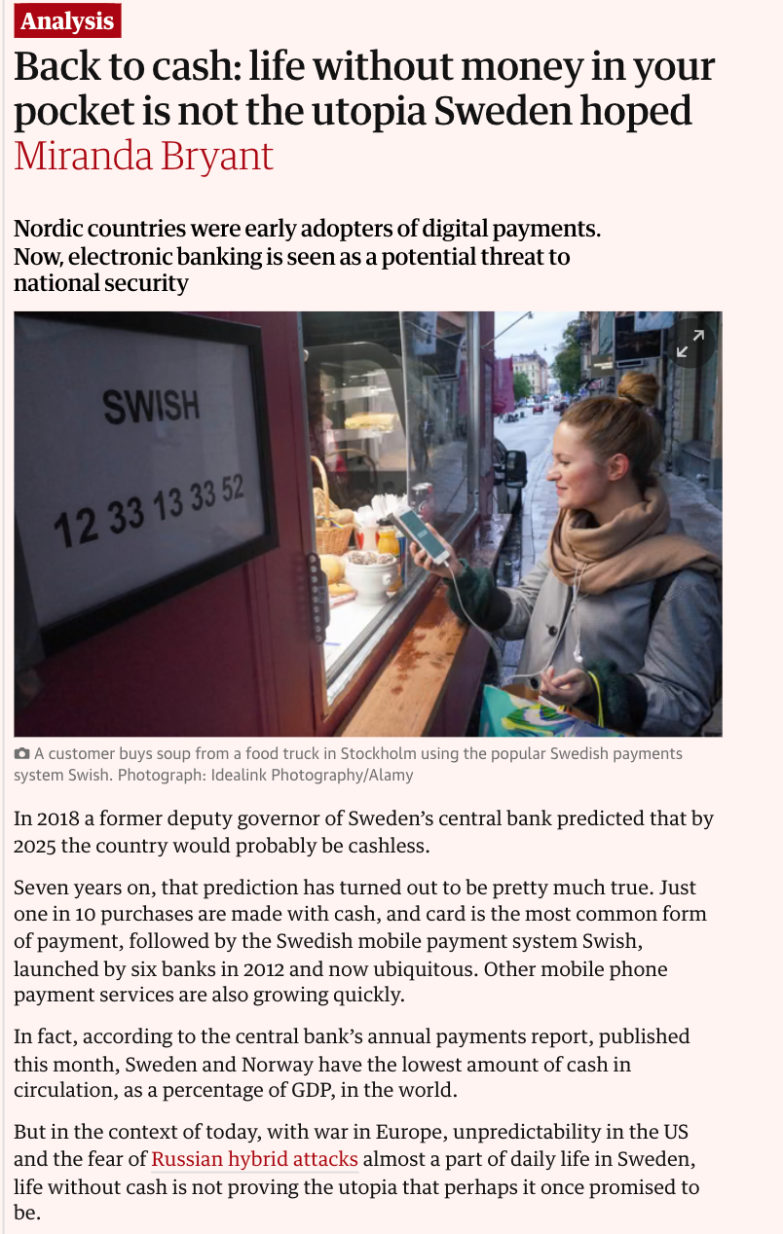
Notes:
Stability = will the segment still exist (in the same shape) as preferences and channels change? Example: Swedish consumers who pay cash. Riksbank survey: 39% paid cash for their most recent purchase in 2010, 13% in 2018, 9% in 2020; 8% in 2022 and 10% in 2023 (last in-store purchase). The Riksbank links the small 2023 rise to cash buffers withdrawn after Russia's full-scale invasion of Ukraine. Payments Report 2025 (10 March 2025): about one in ten in-store purchases is made with cash, while other data (cash in circulation, withdrawals) keep falling. Contrast: in the euro area about half of in-store purchases are in cash (67% Malta, 22% Netherlands). Lesson (textbook p. 83): in a rapidly changing environment the chosen segment must be re-evaluated constantly. Discussion: a firm selling cash-handling services in Sweden vs in Germany? Sources: https://www.riksbank.se/en-gb/payments--cash/payments-in-sweden/payments-in-sweden-2020/1.-the-payment-market-is-being-digitalised/cash-is-losing-ground/the-use-of-cash-is-declining/ ; https://www.riksbank.se/en-gb/payments--cash/payments-in-sweden/payments-report--2024/trends-in-the-payments-market/cash-is-rarely-used-and-the-supply-of-cash-services-is-decreasing/few-people-pay-by-cash-in-stores ; https://www.riksbank.se/en-gb/payments--cash/payments-in-sweden/payments-report-2025/trends-on-the-payments-market/the-swedish-payments-market-is-almost-entirely-digital/cash-use-continues-to-decline/

Slide 56
STABILITY
Will it still be there as preferences and channels change?
Sweden’s cash payers: a segment that is disappearing.
In 2010, 39% of Swedes paid cash for their last purchase. By 2020 it was 9%. In 2023 it rose slightly to 10%, probably because people used cash buffers withdrawn after Russia’s invasion of Ukraine. Cards and Swish took over.
  Is the segment likely to change as a result of a rapidly changing environment?
  Are products in different life-cycle stages across countries?
A segment built on a payment channel can shrink fast, and then move again. Re-evaluate it regularly.
Sources: Sveriges Riksbank, Payments in Sweden 2020; Payments Report 2024 (14 March 2024); Payments Report 2025 (10 March 2025)
Notes:
Stability = will the segment still exist (in the same shape) as preferences and channels change? Example: Swedish consumers who pay cash. Riksbank survey: 39% paid cash for their most recent purchase in 2010, 13% in 2018, 9% in 2020; 8% in 2022 and 10% in 2023 (last in-store purchase). The Riksbank links the small 2023 rise to cash buffers withdrawn after Russia's full-scale invasion of Ukraine. Payments Report 2025 (10 March 2025): about one in ten in-store purchases is made with cash, while other data (cash in circulation, withdrawals) keep falling. Contrast: in the euro area about half of in-store purchases are in cash (67% Malta, 22% Netherlands). Lesson (textbook p. 83): in a rapidly changing environment the chosen segment must be re-evaluated constantly. Discussion: a firm selling cash-handling services in Sweden vs in Germany? Sources: https://www.riksbank.se/en-gb/payments--cash/payments-in-sweden/payments-in-sweden-2020/1.-the-payment-market-is-being-digitalised/cash-is-losing-ground/the-use-of-cash-is-declining/ ; https://www.riksbank.se/en-gb/payments--cash/payments-in-sweden/payments-report--2024/trends-in-the-payments-market/cash-is-rarely-used-and-the-supply-of-cash-services-is-decreasing/few-people-pay-by-cash-in-stores ; https://www.riksbank.se/en-gb/payments--cash/payments-in-sweden/payments-report-2025/trends-on-the-payments-market/the-swedish-payments-market-is-almost-entirely-digital/cash-use-continues-to-decline/

Slide 57
27
How many EU countries ban all alcohol advertising – TV, print, outdoor and online?
EU member states
A None
B One
C Four
D Nine
Hands up: A, B, C or D?

Slide 58
ACCESSIBILITY
Can we reach it: language, media, an open market?
Beer drinkers in Lithuania: there, but hard to reach.
Since 1 January 2018 Lithuania has banned all alcohol advertising: TV, radio, print, outdoor, cinema, sponsorship and the internet – including foreign media sold there. Only alcohol-free beer and wine are exempt.
  Is it possible to communicate with the target consumers?
  Do local law and local media permit access?
The segment is big and easy to measure, but the media route is closed.
Sources: EUCAM, Regulations on alcohol marketing: Lithuania; Galkus et al. (2022), IJERPH 19(19), 12398; Szymura-Tyc (ed.) (2012),
Notes:
Accessibility = can we communicate with the segment and serve it? Textbook (p. 83): language differences raise advertising costs; the market must be open and reachable – local governments and local media must permit access. Example: Lithuania. Since 1 January 2018 a total ban on alcohol advertising: TV, radio, print, outdoor, cinema, internet/digital media and (sports) sponsorship; promotional items only at the point of sale; alcohol-free beer and wine are exempt (EUCAM). The ban also covers foreign media: distributors must not sell publications with alcohol ads (Nordic Alcohol; The Drinks Business). Lithuania was the first EU member state with such a ban (Norway, Iceland, Faroe Islands have similar rules). A 2022 study of Facebook and Instagram found high compliance, also among influencers (Galkus et al., IJERPH 19(19), 12398). So: beer drinkers are a large, measurable segment, but mass media cannot reach them. Ask students: what is left in the mix? (point of sale, product, price, distribution). Ethics note: using 0.0% versions to keep a brand visible is debated as a possible back door ('surrogate' or alibi marketing); Lithuanian researchers have studied exactly this side effect. This is a public-health policy, not a market failure – discuss both views. Sources: https://eucam.info/regulations-on-alcohol-marketing/lithuania ; https://www.mdpi.com/1660-4601/19/19/12398 ; https://www.nordicalcohol.org/lithuania-marketing-and-advertising

Slide 59
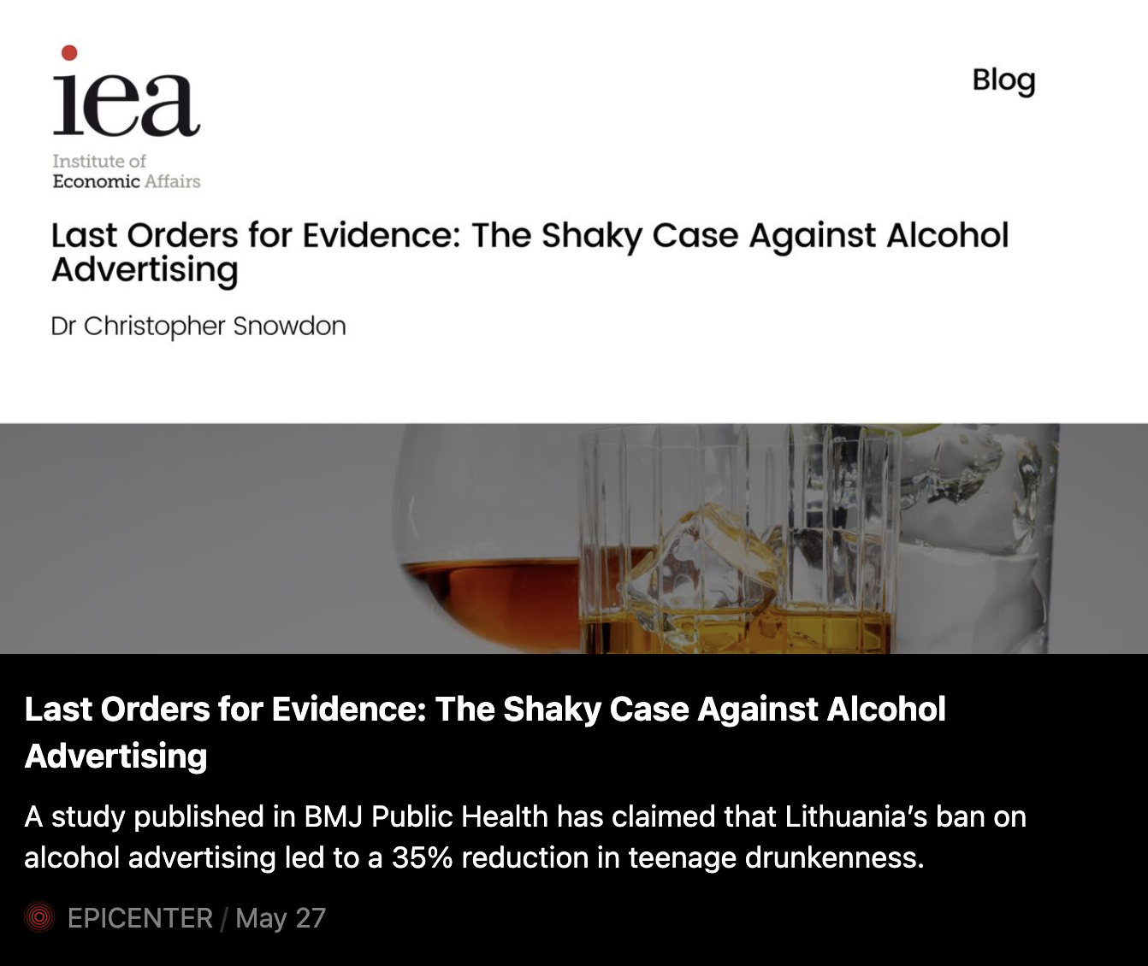
“A study published in BMJ Public Health has claimed that Lithuania’s ban on alcohol advertising led to a 35% reduction in teenage drunkenness. This is a trifle surprising because other studies of alcohol advertising bans have generally found little or no effect on anything.”
Notes:
Accessibility = can we communicate with the segment and serve it? Textbook (p. 83): language differences raise advertising costs; the market must be open and reachable – local governments and local media must permit access. Example: Lithuania. Since 1 January 2018 a total ban on alcohol advertising: TV, radio, print, outdoor, cinema, internet/digital media and (sports) sponsorship; promotional items only at the point of sale; alcohol-free beer and wine are exempt (EUCAM). The ban also covers foreign media: distributors must not sell publications with alcohol ads (Nordic Alcohol; The Drinks Business). Lithuania was the first EU member state with such a ban (Norway, Iceland, Faroe Islands have similar rules). A 2022 study of Facebook and Instagram found high compliance, also among influencers (Galkus et al., IJERPH 19(19), 12398). So: beer drinkers are a large, measurable segment, but mass media cannot reach them. Ask students: what is left in the mix? (point of sale, product, price, distribution). Ethics note: using 0.0% versions to keep a brand visible is debated as a possible back door ('surrogate' or alibi marketing); Lithuanian researchers have studied exactly this side effect. This is a public-health policy, not a market failure – discuss both views. Sources: https://eucam.info/regulations-on-alcohol-marketing/lithuania ; https://www.mdpi.com/1660-4601/19/19/12398 ; https://www.nordicalcohol.org/lithuania-marketing-and-advertising

Slide 60

ACTIONABILITY
Allegro Smart!: free delivery for one fee.
Does it respond to our mix?
Since 2018 Allegro Smart! has given frequent online shoppers free delivery for one subscription fee. By the end of 2025 it had 7.5 million users in Poland and over 1 million abroad. Smart! users buy on average five times more often than other buyers.
  In what way does the segment respond to the applied marketing strategy?
  Can we design a mix that fits how it behaves?
The segment answered the offer. But ask why: heavy buyers are also the most likely to join.
Sources: Allegro, Q1 2025 press release; Allegro, Q4 2025 press release (March 2026); Szymura-Tyc (ed.)
Notes:
Actionability = the segment responds to the marketing strategy, assuming the company targets it with the appropriate mix (textbook p. 83; Table 4.2: 'In what way does the segment respond to the applied marketing strategy?'). Example: Allegro Smart! – a subscription that gives free deliveries for one fee, launched in 2018. Figures from Allegro's own press releases: Smart! closed 2025 with 7.5 million users in Poland and over 1 million in its international markets (Q4 2025 press release, March 2026). Q1 2025 press release: Smart! users on average buy five times more frequently than others and boost merchant sales per offer 2.5 times; over 7 million beneficiaries in Poland saved more than PLN 15 bn since 2018. International: in Slovakia the annual Smart! fee is EUR 11.99 and customers saved almost EUR 100 on delivery on average in 2025 (Allegro.sk press release). CRITICAL CHECK for students: '5 times more often' is a company figure and a correlation – heavy buyers self-select into the subscription, so Smart! does not necessarily CAUSE five times more purchases. The segment is still actionable: it was identified (frequent buyers who dislike paying for delivery), Allegro designed a mix for it (price model + logistics), and it responded with millions of sign-ups. Discussion: would the same offer be actionable in a market with weaker parcel-locker infrastructure? Ethics question: subscriptions can lock customers in and encourage over-buying – where is the line? (The textbook example of Eurobank 'promotion maniacs' illustrates the same logic.) Sources: https://about.allegro.eu/wp-content/uploads/2026/01/Press-release-Q1-2025.pdf ; https://about.allegro.eu/wp-content/uploads/2026/03/Allegro-Q4-2025-Press-release.pdf ; https://www.noviny.sk/pr-spravy/1181594-allegro-sk-hodnoti-rok-2025-rekordne-vianocne-dorucovanie-narast-kazdodennych-nakupov-a-rozsirovanie-lokalnych-partnerstiev

Slide 61
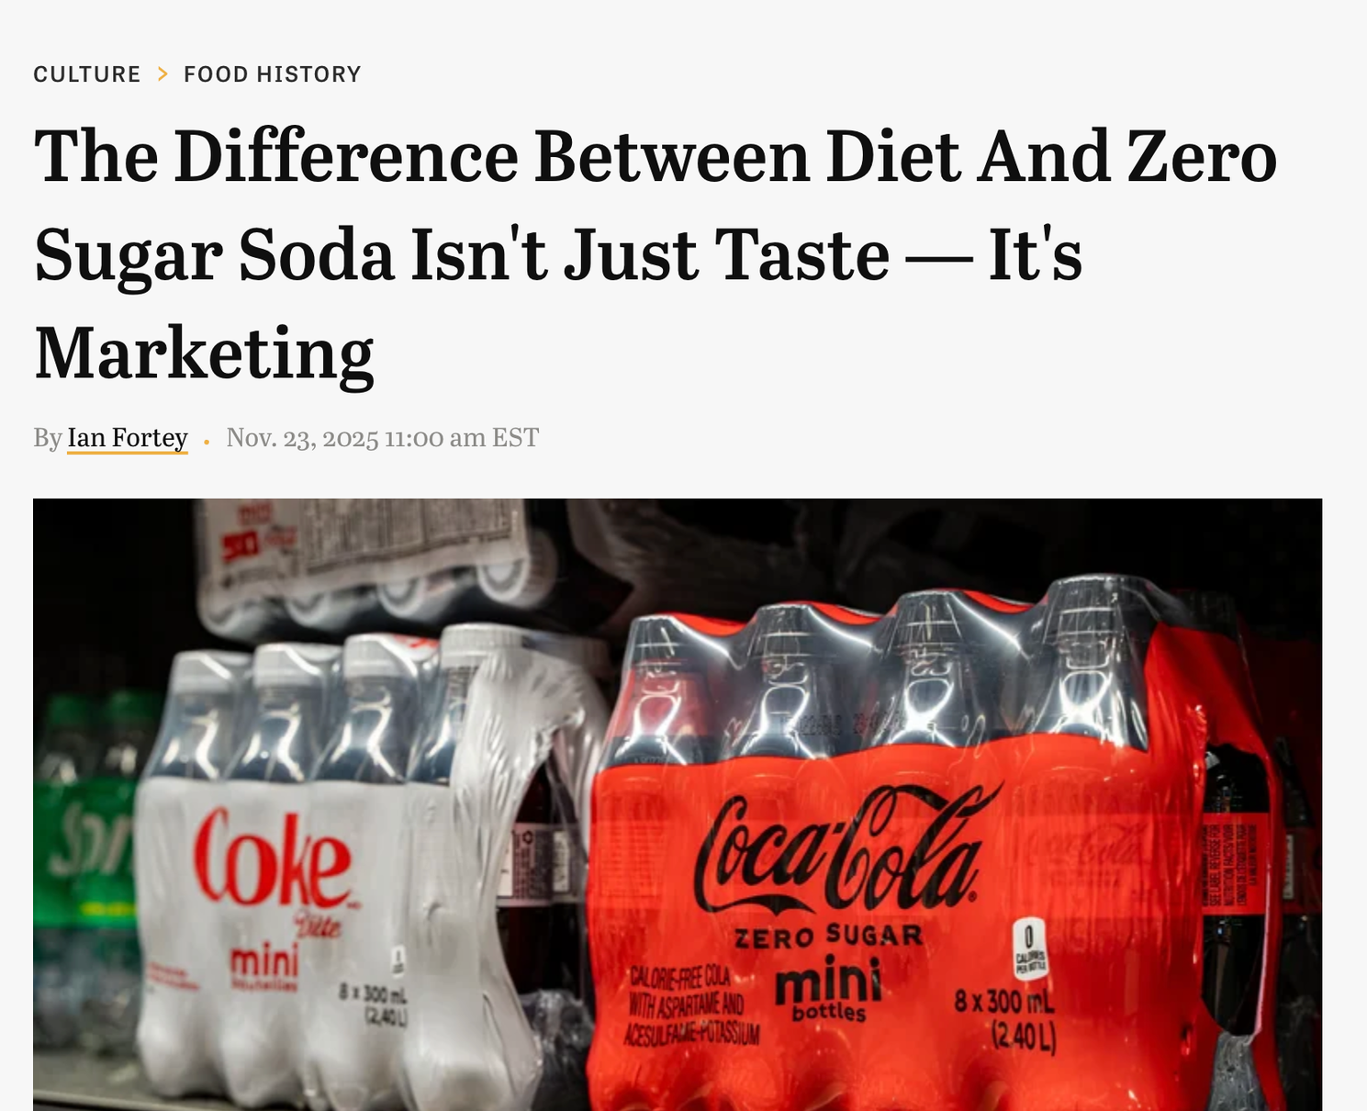
Notes:
Differential response = segments must be distinguishable and react differently to the mix. Textbook (p. 84): if working and non-working women react alike to a perfume sale, they are not separate segments. Real case: Coca-Cola had two zero-calorie colas. Diet Coke (1982) was associated with women and dieting; Coca-Cola executives knew young men largely avoided diet sodas – one called 'diet' a 'four-letter word' for men aged 16–24 (AJC, 2010). Coke Zero launched in the US in 2005: the word 'diet' avoided, taste positioned close to regular Coke. Coca-Cola's own 2005 statement said Coke Zero would not affect support for Diet Coke 'as the target audiences are different' – i.e. two segments, two brands (BevNET, 28 March 2005). PACKAGING TWIST: Coke Zero first came in WHITE cans and bottles. Research found young men associated white packaging with diet drinks, and diet with 'female'. About six months after launch the company switched to black, an idea borrowed from its Australian division (AJC, 2010). By 2010 Coke Zero was sold in 130 countries. Lesson: the segment's different response showed up even in the colour of the can – the mix had to be adjusted after launch. ETHICS / CRITICAL CHECK: this segmentation is built on, and reinforces, a gender stereotype ('diet is for women'). Ask: is it legitimate to exploit a stereotype if it works? Since 14 June 2019 UK advertising rules ban gender stereotypes 'likely to cause harm, or serious or widespread offence' (ads aimed at one gender are still allowed). Sources: https://ajc.com/business/coke-zero-becomes-hero-for-coca-cola/K9fdvFfsyjUK32TUgek17M ; https://www.bevnet.com/news/2005/03-28-2005-coke_pepsi_zero.asp ; https://www.campaignasia.com/article/coke-targets-men-with-new-zero-brand/v5wv238dw0fr7ay7p90kdxixsf

Slide 62
DIFFERENTIAL RESPONSE
EXAMPLE
Does this segment respond differently to the product, price or message than other segments do?
Zero calories, two segments: Diet Coke vs Coke Zero.
Coca-Cola’s US research showed that young men avoided Diet Coke: “diet” felt like a drink for women. In 2005 the company launched Coke Zero – no word “diet”, a taste closer to regular Coke. But consumer feedback showed young men read its white can as “diet”, and “diet” as female. In Australia and New Zealand Coca-Cola launched it in a black can, and the black can soon became the standard everywhere.
  Can the company distinguish segments from each other?
  Do consumers have different preferences in this market?
Sources: McWilliams, J., “Coke Zero becomes hero for Coca-Cola”, Atlanta Journal-Constitution (16 Sept 2010); Coca-Cola North America statement via BevNET (28 March 2005); Szymura-Tyc (ed.) (2012), p. 84
Notes:
Differential response = segments must be distinguishable and react differently to the mix. Textbook (p. 84): if working and non-working women react alike to a perfume sale, they are not separate segments. Real case: Coca-Cola had two zero-calorie colas. Diet Coke (1982) was associated with women and dieting; Coca-Cola executives knew young men largely avoided diet sodas – one called 'diet' a 'four-letter word' for men aged 16–24 (AJC, 2010). Coke Zero launched in the US in 2005: the word 'diet' avoided, taste positioned close to regular Coke. Coca-Cola's own 2005 statement said Coke Zero would not affect support for Diet Coke 'as the target audiences are different' – i.e. two segments, two brands (BevNET, 28 March 2005). PACKAGING TWIST: Coke Zero first came in WHITE cans and bottles. Research found young men associated white packaging with diet drinks, and diet with 'female'. About six months after launch the company switched to black, an idea borrowed from its Australian division (AJC, 2010). By 2010 Coke Zero was sold in 130 countries. Lesson: the segment's different response showed up even in the colour of the can – the mix had to be adjusted after launch. ETHICS / CRITICAL CHECK: this segmentation is built on, and reinforces, a gender stereotype ('diet is for women'). Ask: is it legitimate to exploit a stereotype if it works? Since 14 June 2019 UK advertising rules ban gender stereotypes 'likely to cause harm, or serious or widespread offence' (ads aimed at one gender are still allowed). Sources: https://ajc.com/business/coke-zero-becomes-hero-for-coca-cola/K9fdvFfsyjUK32TUgek17M ; https://www.bevnet.com/news/2005/03-28-2005-coke_pepsi_zero.asp ; https://www.campaignasia.com/article/coke-targets-men-with-new-zero-brand/v5wv238dw0fr7ay7p90kdxixsf

Slide 63
What can go wrong?
Notes:
End on the remedy, not the warnings. Three one-minute stories, then the exit ticket.
6

Slide 64
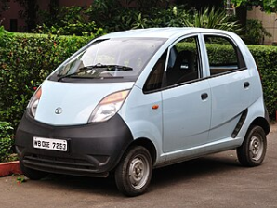

SUBSTANTIALITY
Is it large and profitable enough, and is it growing?
MEASURABILITY
STABILITY
Can we size it: numbers, purchasing power, preferences?
Will it still be there as preferences and channels change?
ACCESSIBILITY
Can we reach it: language, media, an open market?
DIFFERENTIAL RESPONSE
Does it react differently?
ACTIONABILITY
Does it respond to our mix?

Slide 65
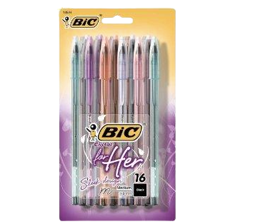
SUBSTANTIALITY
Is it large and profitable enough, and is it growing?
MEASURABILITY
STABILITY
Can we size it: numbers, purchasing power, preferences?
Will it still be there as preferences and channels change?
ACCESSIBILITY
Can we reach it: language, media, an open market?
DIFFERENTIAL RESPONSE
Does it react differently?
*The pink tax is the extra price charged
for products marketed to women
ACTIONABILITY
Does it respond to our mix?

Slide 66

SUBSTANTIALITY
Is it large and profitable enough, and is it growing?
MEASURABILITY
STABILITY
Can we size it: numbers, purchasing power, preferences?
Will it still be there as preferences and channels change?
ACCESSIBILITY
Can we reach it: language, media, an open market?
DIFFERENTIAL RESPONSE
Does it react differently?
ACTIONABILITY
Does it respond to our mix?

Slide 67
Macro segmentation vs microsegmentation
Notes:
Quick exercise (3–5 min): drag each chip into a column (works in Canva edit mode) or ask students to shout it out. Rule: does the source give one number per COUNTRY (macro data) – or answers from individual PEOPLE that can be grouped across borders (micro data)?
START FROM COUNTRIES: World Bank Open Data, IMF World Economic Outlook, Eurostat (mostly country/region tables; some EU surveys also have microdata), Freedom House, RSF Press Freedom Index, WEF Global Gender Gap, DataReportal (country-level digital statistics), Hofstede scores.
START FROM CONSUMERS: World Values Survey (individual respondents in 100+ countries – you can group people by values across borders), Eurobarometer (individual opinions of EU citizens), Reuters Institute Digital News Report (c. 100,000 respondents in 48 countries – media habits by age group), Deloitte Gen Z & Millennial Survey (a cross-border generational segment by design).
TRAP: Hofstede is about culture, so many students put it under 'consumers'. But Hofstede gives ONE score per country – an average. It describes countries, not individual consumers (do not apply national scores to individuals). Link back to 'culture is a lens, not a catch-all explanation'.
Takeaway: most free data starts from countries. For inter-market segmentation you need person-level surveys – or your own primary research.

Slide 68
STAGE 1 · MACRO-SEGMENTATION (TRADITIONAL)
  Unit: countries, grouped into clusters of similar markets
  Looks at: common characteristics of country markets
  Data: secondary data, objective variables that exist regardless of the firm’s marketing
  Bases: independent of the product – observable (demographic, socio-economic, cultural) or unobservable (lifestyle, values)
  Asks: which countries offer the most opportunity?
  Secondary data
Group the countries
Initial screening: only the countries that pass go on to stage 2
STAGE 2 · MICRO-SEGMENTATION 9MODERN)
  Unit: consumers, grouped into local segments that are similar across the countries in a cluster
  Looks at: diversity within each country market
  Basis: similar demand structures and consumer habits in different markets
  Asks: which consumers, in which countries, will respond alike?
Find similar consumers inside
Source: Szymura-Tyc (ed.) (2012), pp. 84–85 (after Duliniec 2004, p. 178)
Notes:
Two stages of international segmentation (Szymura-Tyc (ed.) 2012, pp. 84–85, after Duliniec 2004, p. 178). MACRO-SEGMENTATION: dividing a number of countries into subgroups of more similar clusters, based on common characteristics. Uses secondary data; variables are objective, i.e. they exist regardless of the firm's marketing actions. Bases are independent of the product and can be observable (demographic, socio-economic, cultural) or unobservable (lifestyle, values). The procedure concerns only country markets or their groups. MICRO-SEGMENTATION: identifying local segments that are similar across the countries in a cluster; concerns the internal heterogeneity of individual country markets. Applies only to country markets that passed the initial screening. Decision driver: similar structures of demand and similar consumer habits in segments of different markets. LINK: most criteria work at both levels, e.g. per capita income can group countries and also segment consumers within a country into regional segments; geographic segmentation can likewise be done between and within countries. Ask students: in your essay country, which macro criteria put it in a cluster – and which micro segment inside it would you target?

Slide 69
Four lenses for grouping countries
MARKET POTENTIAL
POLITICAL, LEGAL & FINANCIAL
COMPETITION
MARKETING SUPPORT INFRASTRUCTURE
How big is the prize?
Can we operate safely?
Who is already there?
Can we get the mix to market?
GDP per capita, GDP growth rate, consumer buying power, current market size and anticipated growth, international investment figures
Legal ambiguity, trade barriers, exchange rate controls, political risk, agreements
Types of competitors, structure of competition, perceived differentiation
Distribution and logistics providers, alliance partners, telecoms, local advertising support, research, financial and consulting firms
World Bank World Development Indicators, IMF World Economic Outlook, UNCTAD World Investment Report, Eurostat, OECD
World Bank B-READY, Worldwide Governance Indicators, Transparency International CPI, WTO Tariff Profiles, IMF AREAER, Coface/PRS country risk ratings
Euromonitor Passport, Statista, Orbis, competitors’ annual reports, chambers of commerce, Google Trends
World Bank LPI 2.0, ITU, DataReportal, ESOMAR Directory, PAI
Check: these criteria describe countries, not buyers. PESTEL & CAGE may help; again, culture, values and aspirations are hard to assess.
Source: Szymura-Tyc (ed.) (2012), pp. 84–85 and Table 4.3 (after Lascu 2009)
Notes:
Table 4.3 'Selected criteria for macro-segmentation' (Szymura-Tyc (ed.) 2012, p. 85, after Lascu 2009). Market potential: GDP per capita, GDP growth rate, consumer buying power, market current size and anticipated growth, international investment figures. Political, legal and financial environment: legal ambiguity, trade barriers, exchange rate controls, political risk. Competition: types of competitors, structure of competition, perceived differentiation. Marketing support infrastructure: availability of distribution and logistics providers, competent partners for strategic alliances, local telecommunications development, local advertising support, availability of other service providers (marketing research, financial, management consulting firms). The questions on the cards ('How big is the prize?' etc.) are our teaching shorthand, not from the book. Point to make: these criteria group and screen country markets only; the segments themselves come at the micro stage. Link to the Lithuania slide: a total alcohol ad ban sits under 'political, legal' AND 'marketing support infrastructure' (local advertising support). Ask: which of the four lenses would matter most for your essay product?

Slide 70
Bases of segmentation
Notes:
Quick exercise (3–5 min): drag each chip into a column (works in Canva edit mode) or ask students to shout it out. Rule: does the source give one number per COUNTRY (macro data) – or answers from individual PEOPLE that can be grouped across borders (micro data)?
START FROM COUNTRIES: World Bank Open Data, IMF World Economic Outlook, Eurostat (mostly country/region tables; some EU surveys also have microdata), Freedom House, RSF Press Freedom Index, WEF Global Gender Gap, DataReportal (country-level digital statistics), Hofstede scores.
START FROM CONSUMERS: World Values Survey (individual respondents in 100+ countries – you can group people by values across borders), Eurobarometer (individual opinions of EU citizens), Reuters Institute Digital News Report (c. 100,000 respondents in 48 countries – media habits by age group), Deloitte Gen Z & Millennial Survey (a cross-border generational segment by design).
TRAP: Hofstede is about culture, so many students put it under 'consumers'. But Hofstede gives ONE score per country – an average. It describes countries, not individual consumers (do not apply national scores to individuals). Link back to 'culture is a lens, not a catch-all explanation'.
Takeaway: most free data starts from countries. For inter-market segmentation you need person-level surveys – or your own primary research.

Slide 71



GEOGRAPHIC
Neighbours across borders
Can be performed at the macro-segmentation level, as well as internally, identifying different consumer segments within a given geographic region. Dividing markets into geographic subsets. This usually means the selection of countries that are located close to one another, based on the assumption that they will have many common traits and behaviours
DEMOGRAPHIC
GEODEMOGRAPHIC
PSYCHOGRAPHIC
BEHAVIOUR & BENEFIT
Age, income, family
Where you live
Lifestyles and values
What they do and seek
Europe is ageing. The 60+ “Golden Greys” are active, relatively affluent and open to new experiences.
Catch: many attitudes are not driven by demographics.
Geography + demographics: similar people live in similar places, even across borders.
1989: six clusters, e.g. S. Germany + N. Italy + Austria.
Today: Mosaic (Europe, China, Japan), PRIZM (US, Canada).
European tools: CCA, Kompas, social milieus, GfK Euro-Socio-Styles (8 “worlds”).
Catch: US-made VALS misleads when used blindly elsewhere.
Usage rate, loyalty, occasion, benefit sought: safety, image or speed in a car.
Catch: you need primary data.
Secure World, Magic World, Authentic World,
Standing World, New World, Challenged World, Harmonious World
Cosmopolitan World
Euro-Socio-Styles®
Notes:
GEODEMOGRAPHIC: textbook (p. 87) – Vander-Merwe & L'Huillier (1989) found six cross-border clusters; consumers in different countries can be closer to each other than to others in their own country. Catch: the clusters predate the 2004/2007 EU enlargements. GLOBAL CLUSTERS TODAY: Experian's Mosaic Global applies the same idea worldwide. It is based on the idea that the world's cities share common patterns of residential segregation. It combines 24 national Mosaic classifications and covers about 880 million people in North America, Europe and Asia Pacific (Experian UK). A rebuild of Mosaic Global identified ten socio-economic groups found across the developed world, with names such as 'Sophisticated Singles', 'Post Industrial Survivors' and 'Low Income Elders'; the share of each group varies by country. Each national version uses local data, but the method is the same, so firms can compare customers across markets (e.g. Swiss Sense, a European bedding retailer, used Mosaic to plan international growth – Experian case study, Jan 2025). Ask students: is a 'Sophisticated Single' in Warsaw more like one in Madrid than like a rural pensioner in Poland? Caution: Mosaic is a commercial product; Experian's descriptions are marketing material, not independent research. Sources: https://www.experian.co.uk/www/pages/what_we_offer/products/mosaic_global.html ; https://www.insidearm.com/news/00021424-experian-establishes-the-worlds-most-comp/ ; https://www.experian.com/blogs/marketing-forward/swiss-sense-developed-a-data-driven-international-growth-strategy-using-experian-mosaic-data/

Slide 72
What can go wrong
Notes:
Quick exercise (3–5 min): drag each chip into a column (works in Canva edit mode) or ask students to shout it out. Rule: does the source give one number per COUNTRY (macro data) – or answers from individual PEOPLE that can be grouped across borders (micro data)?
START FROM COUNTRIES: World Bank Open Data, IMF World Economic Outlook, Eurostat (mostly country/region tables; some EU surveys also have microdata), Freedom House, RSF Press Freedom Index, WEF Global Gender Gap, DataReportal (country-level digital statistics), Hofstede scores.
START FROM CONSUMERS: World Values Survey (individual respondents in 100+ countries – you can group people by values across borders), Eurobarometer (individual opinions of EU citizens), Reuters Institute Digital News Report (c. 100,000 respondents in 48 countries – media habits by age group), Deloitte Gen Z & Millennial Survey (a cross-border generational segment by design).
TRAP: Hofstede is about culture, so many students put it under 'consumers'. But Hofstede gives ONE score per country – an average. It describes countries, not individual consumers (do not apply national scores to individuals). Link back to 'culture is a lens, not a catch-all explanation'.
Takeaway: most free data starts from countries. For inter-market segmentation you need person-level surveys – or your own primary research.

Slide 73
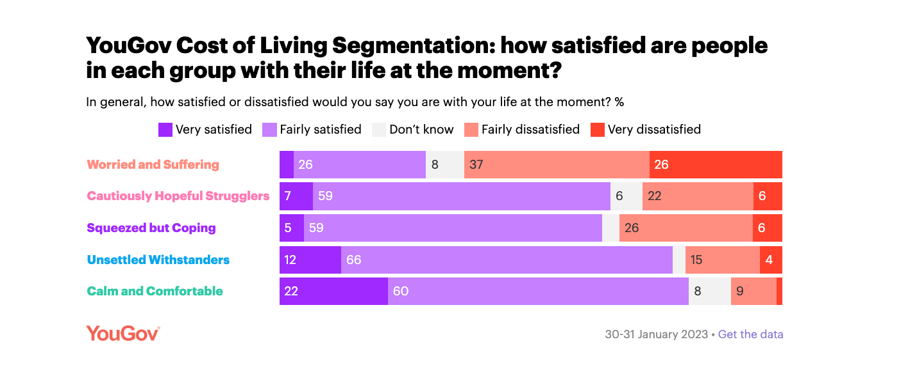
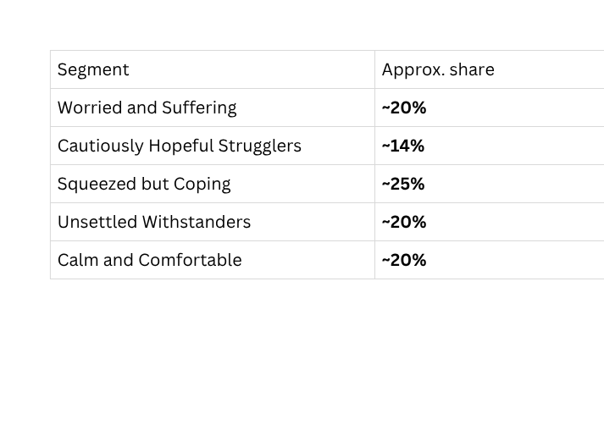
Notes:
Answer: B – 22.0%, i.e. 99 million people aged 65+ in the EU on 1 January 2025 (EU population 450.6 million). Up 0.4 pp on 2024 and 2.9 pp on 2015; the share rose in every EU country. Follow-up question: does '22% of Europeans' make this ONE segment? No – income, health, digital skills and lifestyle differ hugely (textbook p. 86: 'Golden Greys' are active and relatively affluent, but many attitudes are not driven by age). Size passes the substantiality test; the other five tests still apply. Source: Eurostat, Population structure and ageing (data extracted Feb 2026): https://ec.europa.eu/eurostat/statistics-explained/index.php/Population_structure_and_ageing

Slide 74
Choosing where to play
SCREENING IN FOUR STAGES (KOTABE & HELSEN)
THREE STRATEGIES
Score the countries
How many segments?
1 Pick indicators: size, growth, risk, competition
2 Weight them: constant sum, e.g. 100 points
3 Rate each country, e.g. 0–4 (as in BERI)
4 Add up an attractiveness score
  Standardised: one mix for all of Europe
  Concentrated: one segment, a unique mix
  Differentiated: several segments, a mix for each (VW group: Porsche, Škoda, Golf)
Ethnocentric or Geocentric
Polycentric lub Regiocentric
Geocentric
Source: Szymura-Tyc (ed.) (2012), pp. 90–93 (after Kotabe & Helsen 2010; Arnold 2004)

Slide 75
Positioning
Notes:
Quick exercise (3–5 min): drag each chip into a column (works in Canva edit mode) or ask students to shout it out. Rule: does the source give one number per COUNTRY (macro data) – or answers from individual PEOPLE that can be grouped across borders (micro data)?
START FROM COUNTRIES: World Bank Open Data, IMF World Economic Outlook, Eurostat (mostly country/region tables; some EU surveys also have microdata), Freedom House, RSF Press Freedom Index, WEF Global Gender Gap, DataReportal (country-level digital statistics), Hofstede scores.
START FROM CONSUMERS: World Values Survey (individual respondents in 100+ countries – you can group people by values across borders), Eurobarometer (individual opinions of EU citizens), Reuters Institute Digital News Report (c. 100,000 respondents in 48 countries – media habits by age group), Deloitte Gen Z & Millennial Survey (a cross-border generational segment by design).
TRAP: Hofstede is about culture, so many students put it under 'consumers'. But Hofstede gives ONE score per country – an average. It describes countries, not individual consumers (do not apply national scores to individuals). Link back to 'culture is a lens, not a catch-all explanation'.
Takeaway: most free data starts from countries. For inter-market segmentation you need person-level surveys – or your own primary research.

Slide 76
Marketers have long believed that brands with strong, differentiated positioning are more likely to be successful than poorly differentiated offerings.

Slide 77
Positioning
Positioning: establishing the offer in consumers' minds and differentiating it from competitors (Kotler 1997). A home-market position does not travel automatically. Product position: a complex set of perceptions, impressions and feelings towards the product.
ATTRIBUTE / BENEFIT
USE / USER
COMPETITOR
What does it do for me?
When, and who for?
How are we different?
Sell what it does for you: Volvo = safety. Abroad, “imported” can be a benefit.
How the product is used, or who uses it
Airbus: two engines or four? An implicit jab at Boeing
QUALITY / PRICE
PRODUCT CLASS
What is it worth?
Which shelf is it on?
Premium products sold at double the price or more
Which category it competes in
GLOBAL POSITIONING
works best at the two ends of a continuum: high-tech (buyers share an expert language) and high-touch (romance, wealth: fragrance, fashion, gold).
Source: Szymura-Tyc (ed.) (2012), pp. 94–97 (after Keegan 1999)

Slide 78
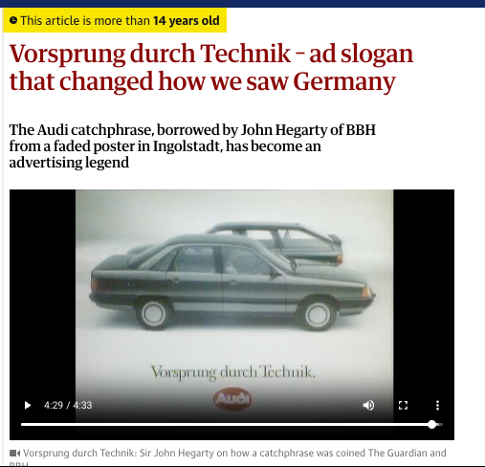






At the time, popular perceptions of Germany – in Britain at least – were still wrapped up in the legacy of the past. "Don't mention the war," barked Basil Fawlty, but people still did.

Slide 79

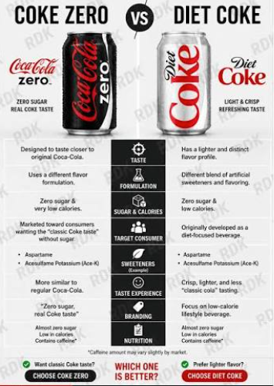
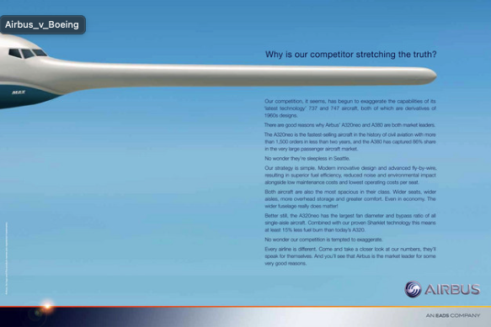

Slide 80
Which positioning
strategy is it?
Notes:
Quick test: 13 slides, one brand each. Students vote with hands (A–F). Answers and sources are in the speaker notes of each slide. The same quiz is also in Mentimeter ('Positioning strategies – quiz') if you prefer phone voting with live results.

Slide 81

Xiaomi (2018) pledged its hardware net profit margin will never exceed 5%, returning any excess to users.
A Attribute / benefit
B Quality / price
C Use / user
D Product class
E Competitor
F Global positioning (high-tech / high-touch)
Notes:
Answer: B – Quality / price. 'Innovation at honest prices': Xiaomi's 2018 Hong Kong IPO prospectus pledged that the overall net profit margin of its hardware business would not exceed 5% a year, with any excess returned to users. Source: Xiaomi prospectus, HKEX (June 2018); Bloomberg, 25 April 2018.

Slide 82
Audi (1982): UK ads kept the German slogan ‘Vorsprung durch Technik’ untranslated – it simply said ‘we’re German’.
A Attribute / benefit
B Quality / price
C Use / user
D Product class
E Competitor
F Global positioning (high-tech / high-touch)
Notes:
Answer: A – Attribute / benefit. German origin itself is the benefit: it signals engineering quality (same logic as 'imported' on the positioning slide). BBH's John Hegarty spotted the line on an old poster in Ingolstadt in 1982; the IPA effectiveness paper reports Audi's UK market share grew five-fold. Source: WARC/IPA, 'Audi: The value of Vorsprung durch Technik over four decades'.

Slide 83
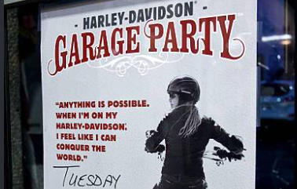
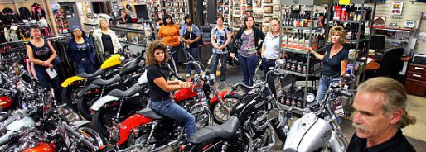
Harley-Davidson (2010s): women-only ‘Garage Parties’ to bring women who had never ridden into motorcycling.
A Attribute / benefit
B Quality / price
C Use / user
D Product class
E Competitor
F Global positioning (high-tech / high-touch)
Notes:
Answer: C – Use / user (a NEW user group). Harley ran women-only 'Garage Parties' for women interested in riding but unsure how to start. Discussion: a 2020 CUNY analysis found a decade of outreach brought women into showrooms but not big sales – Harley's ads still mostly showed men. A new user group needs more than one campaign. Date '2010s' is approximate. Sources: RevZilla/MIC survey (2015); CUNY Covering Companies (2020).

Slide 84
7Up (1968) called itself ‘The Uncola’.
A Attribute / benefit
B Quality / price
C Use / user
D Product class
E Competitor
F Global positioning (high-tech / high-touch)
Notes:
Answer: D – Product class. 7Up positioned itself against a whole category (colas), not one brand: 'the structural alternative to Coca-Cola and Pepsi'. Some students will say E (Competitor) – good discussion: is 'cola' a competitor or a category? The campaign ran from 1968 to the mid-1970s (J. Walter Thompson). Source: Everything PR, 7Up marketing history (2026).

Slide 85
POSITIONING · QUICK TEST 6/13
Avis (1962): ‘We’re only No. 2 in rent-a-cars. So we try harder.’
A Attribute / benefit
B Quality / price
C Use / user
D Product class
E Competitor
F Global positioning (high-tech / high-touch)
Notes:
Answer: E – Competitor. Avis defined itself directly against the market leader, Hertz. Doyle Dane Bernbach's campaign (1962): within a year Avis went from a $3.2 million loss to a $1.2 million profit – its first profit in more than a decade. Source: Jalopnik, 'How to make someone feel bad for being number #1'.

Slide 86

Chanel No. 5 (since 1921) uses essentially the same romance-and-luxury advertising in every market.
A Attribute / benefit
B Quality / price
C Use / user
D Product class
E Competitor
F Global positioning (high-tech / high-touch)
Notes:
Answer: F – Global positioning (high-touch end). Fragrance appeals to universal themes of romance and luxury, so one global position can work everywhere (Keegan's continuum). '1921' is the launch of the perfume, not of one campaign. Source: Jones, A. (2016), 'Chanel and Chanel No. 5: A global marketing and advertising strategy', UVic B.Com. research paper (student paper – use as a starting point).

Slide 87

FedEx (1978): ‘When it absolutely, positively has to be there overnight.’
A Attribute / benefit
B Quality / price
C Use / user
D Product class
E Competitor
F Global positioning (high-tech / high-touch)
Notes:
Answer: A – Attribute / benefit. One attribute owned by the brand: guaranteed overnight reliability. The 1978–1983 campaign (Ally & Gargano) showed the danger of sending important packages with less dependable carriers. Source: WARC, 'Federal Express Corporation: When It Absolutely, Positively Has To Be There Overnight campaign (1978–1983)'.

Slide 88

Swatch (1983) sold a Swiss watch as a cheap, colourful fashion accessory.
A Attribute / benefit
B Quality / price
C Use / user
D Product class
E Competitor
F Global positioning (high-tech / high-touch)
Notes:
Answer: D – Product class. Swatch moved the watch into another category – fashion accessories – instead of competing as a timepiece with cheap Japanese quartz watches. A Credit Suisse analyst called it a 'brilliant idea to sell the Swatch as a fashion accessory'. Source: swissinfo.ch, 'The Swatch celebrates its 20th birthday'.

Slide 89
Source of data: secondary or primary?
Notes:
Szymura-Tyc (p. 63): primary data are collected for the project at hand; secondary data were gathered by someone else and/or for another purpose. Abroad, secondary data are especially valuable because primary data are costly and difficult; Malhotra & Peterson predict more problems will be solved with secondary data alone.
Onkvisit & Shaw (ch. 8): no research should start without a search for secondary data; evaluate purpose, methodology, definitions and time period. Cross-country data may not be comparable: different collection methods, classifications, units and definitions (the 'urban' example).
IKEA: CNN via WRAL (2018). Sources differ on how long the research lasted (from about 3 years to 12 years of preparation); all agree on 1,000+ home visits.
Bottom line is our illustration: whether data are primary or secondary depends on who uses them and for what.

Slide 90
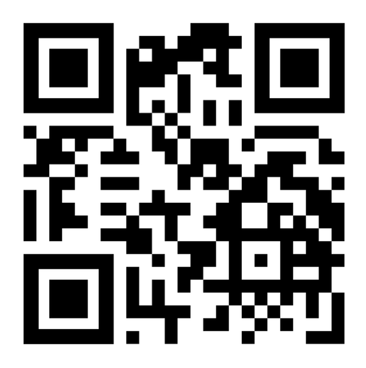
To-do list
  Which presented database did you find the most interesting, and why?
  Name one database or report we have not discussed in class/presentet materials.
What does it offer, and when/for what purpose would it be useful?
  Share (describe, provide link if possible) an advert or advertising campaign with an interesting positioning strategy. Which strategy does it use, and why does it work?
Notes:
Lecture 5 (5 November). Differentiation of consumers' behaviour on international markets (I): culture. Key reading: Szymura-Tyc (ed.) (2012), ch. 2, pp. 45–58. Supporting: Onkvisit & Shaw (2004), ch. 6–7.

